Slide 1
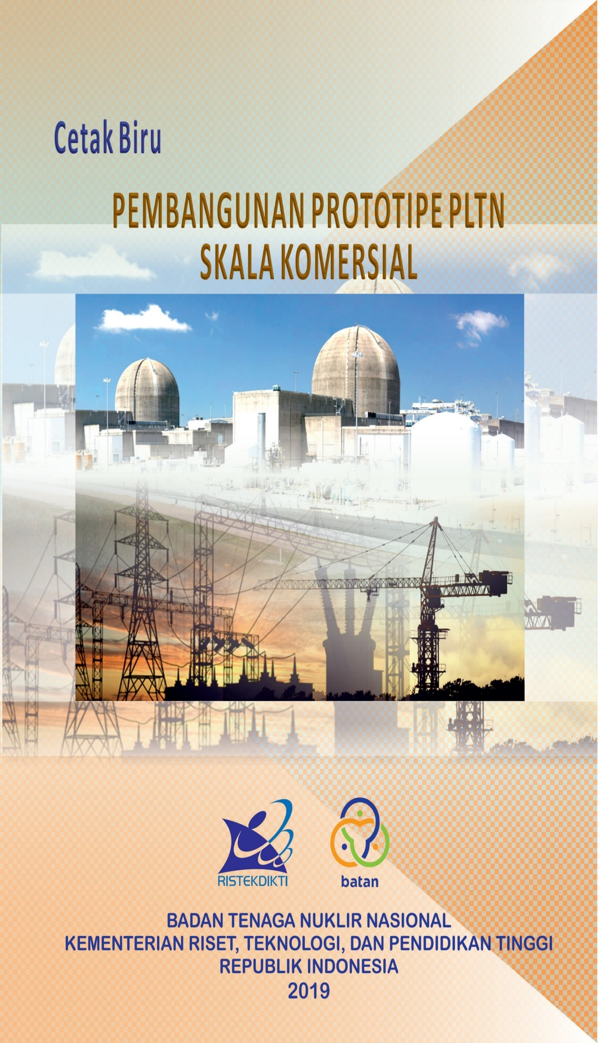
NUCLEAR POWER PROGRAM IN INDONESIA: POTENTIAL AND CHALLENGES
:IAEA National Workshop on:
Industrial Involvement
Jakarta, 24 – 27 February 2020
Suparman
Center for Nuclear Energy System Assessment
National Nuclear Energy Agency

Slide 2
CONTENTS
INTRODUCTION
STATUS OF NPP IN THE WORLD
PROSPECT AND POTENTIAL OF NUCLEAR ENERGY
STATUS OF NUCLEAR POWER PROGRAM
CHALLENGES
POLICY AND STRATEGY
FUTURE PLAN

Slide 3
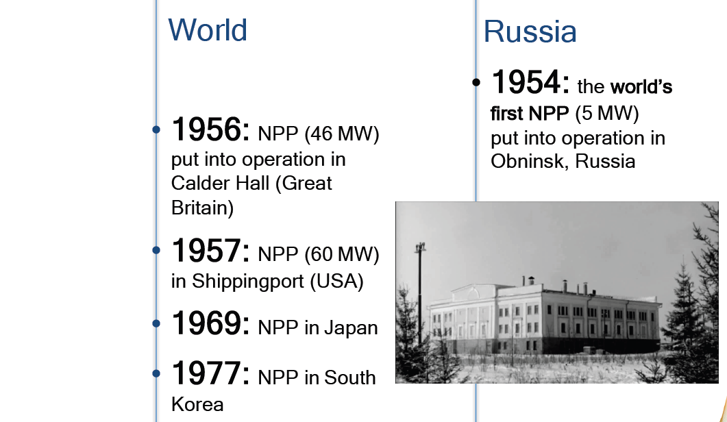
WORLD NPP HISTORY

Slide 4


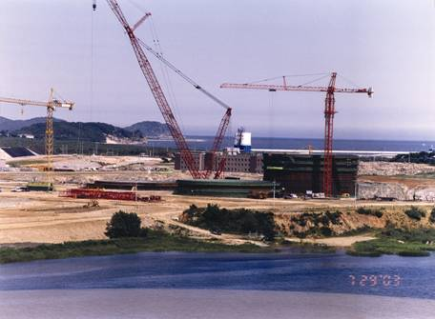
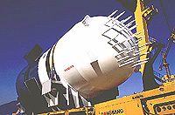
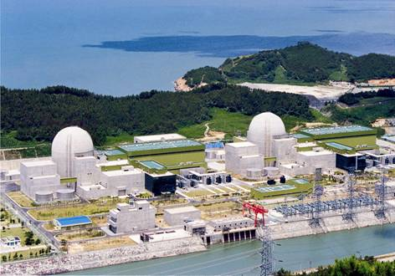
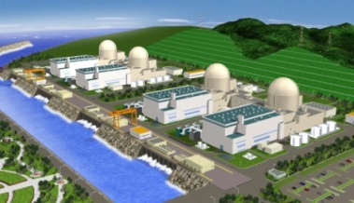
KOREA NPP HISTORY
1970s
1980s
1990s
2000s
Introduction
of Nuclear Power
Promotion of
Localization
Technology
Self-reliance
Development of
Advanced Reactor
Construction
of Kori #1 (`71-`78)
Establishment of
Localization Plan (`84)
OPR1000
Development (`95)
APR1400
Development (`01)
* OPR1000 (Optimized Power Reactor 1,000) is renamed from the former KSNP.
Proprietary DOOSAN

Slide 5
INDONESIA NPP HISTORY
National Priority Program
FS of West Kalimantan
Nuclear Law 10/1997
Reactor Non-Commercial
BANGKA FS
2011-2013
Muria FS
1992-1995
DG of IAEA visit Indonesia
1996
1986
Economic Crisis
INIR MISSION
Fukushima
Chernobyl
Reformation
1970
1980
1990
2000
2010
2014-2018
2020
Before NUCLEAR LAW
After NUCLEAR LAW

Slide 6
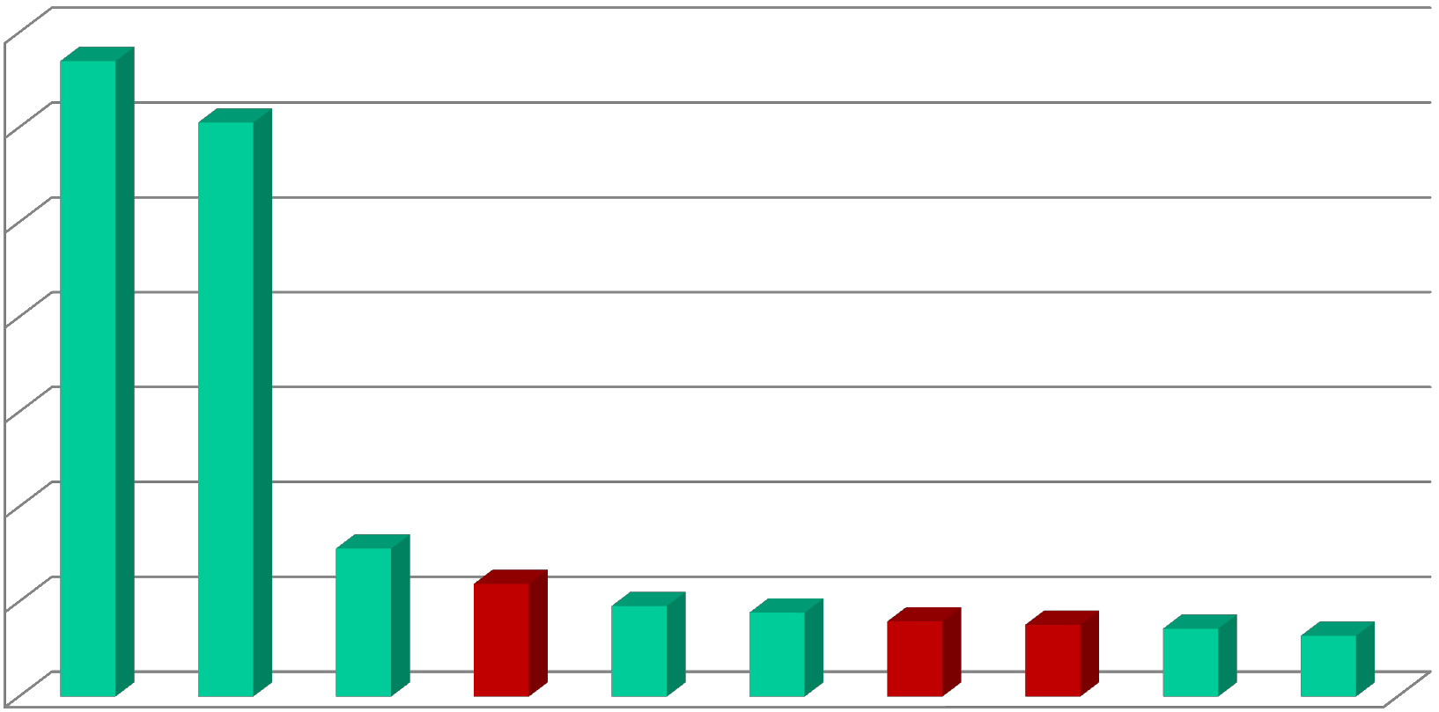







10 DENSELY POPULATED COUNTRY
1,400,000,000
NPP
1,200,000,000
NO NPP
1,000,000,000
800,000,000
600,000,000
400,000,000
200,000,000
-
BANGLADESH START CONTRUCT NPP

Slide 7
NPP STATUS IN THE WORLD
Electricity contribution: 10,4%

Slide 8
UNDER CONSTRUCTION

Slide 9
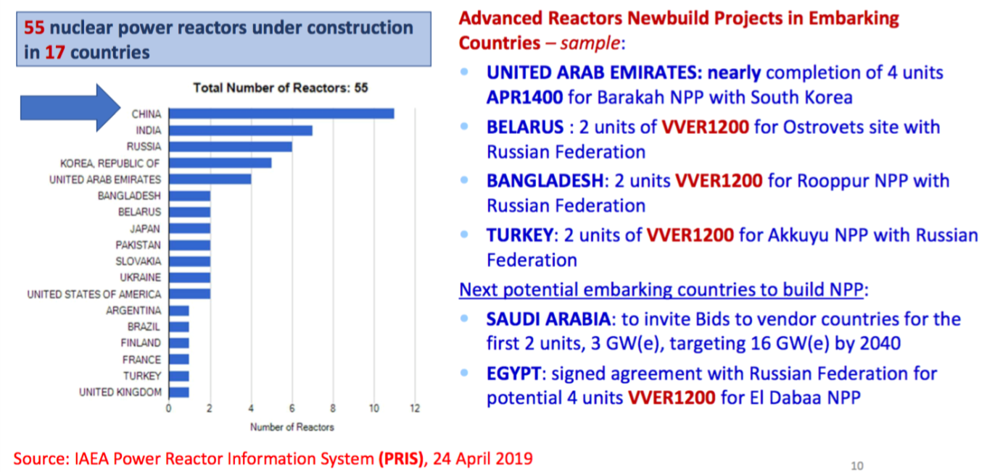
UNDER CONSTRUCTION

Slide 10
REACTOR TYPE

Slide 11
Why we need nuclear?
Electricity demand increase rapidly
Economic growth
The need for a better life
To support industrialization
Limited fossil energy resources
The issue of global warming
The basic infrastructure (soft and hard) supporting the use of nuclear power plants is largely ready

Slide 12
Indicator
Electricity per capita: 1064 kWh/cap
Minimum electricity per capita for developed country: 4.000 kWh/cap
1.064 kWh/cap
2.500 kWh/cap
7.000 kWh/cap
2050
2025
2019
NATIONAL TARGET

Slide 13

TARGET OF ENERGY MIX
PRESENT CONDITION
 | 2016 | 2025 | 2050
Role of energy | Commodity | As development capital
Renewable mix | 7.7% | 23% | 31%
Energy supply | 169 MTOE | 400 MTOE | 1.021 MTOE
Power plant Capacity | 59 GW (EBT 8 GW) | 136 GW (EBT > 45 GW) | 443 GW (EBT > 167 GW)
Energy elasticity | 1 | < 1 | < 1
Electricity /capita/year | 865 KWh | 2.500 kWh | 7.000 kWh
Electrification Ratio | 88% | ∼100% | ∼100%
New and renewable
Coal
Oil
Gas

Slide 14
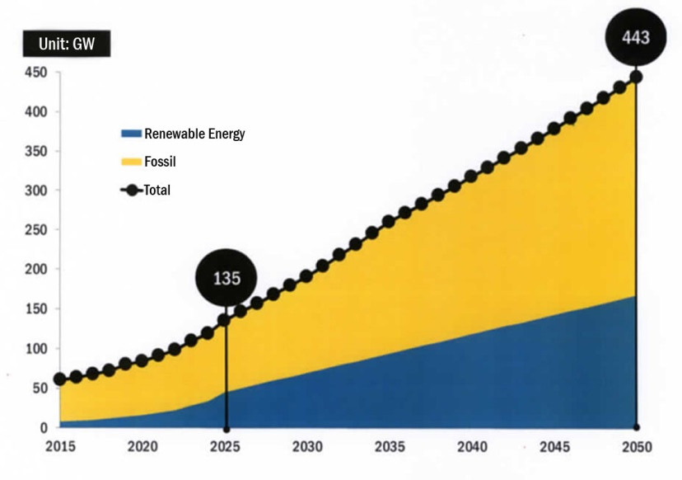
Target of Installed Capacity

Slide 15
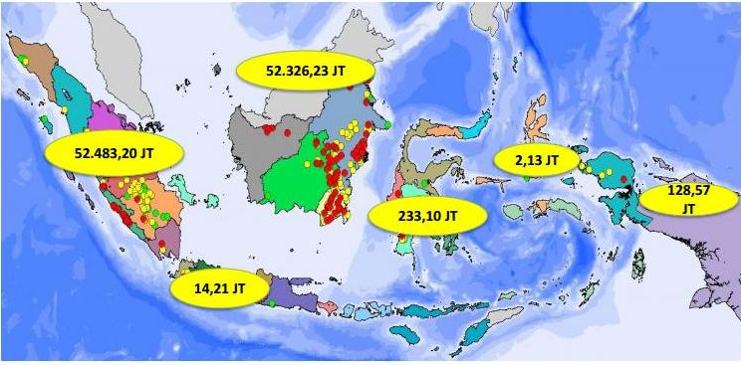
FOSIL ENERGY RESOURCES
KALIMANTAN
Coal | 52.326,23 JTon
Oil | 669,24 MMSTB
Gas | 17,36 TSCF
MALUKU
Coal | 2,13 JTon
Oil | 37,92 MMSTB
Gas | 15,22 TSCF
SUMATERA
Coal | 52.483,20 JTon
Oil | 5.299,47 MMSTB
Gas | 133,55 TSCF
SULAWESI
Coal | 233,10 JTon
Oil | 49,11 MMSTB
Gas | 3,88 TSCF
PAPUA
Coal | 128,57 JTon
Oil | 65,73 MMSTB
Gas | 23,91 TSCF
JAWA
Coal | 14,21 JTon
Oil | 1.631,34 MMSTB
Gas | 9,97 TSCF
COAL ~ 50 years, OIL ~ 10-13 years, GAS ~ 30 years

Slide 16
POTENTIAL
Indonesia has experiences in build and operate conventional power plants as well as nuclear research reactors:
  technical personnel,
  education, training and personnel certifications system,
  Regulations
National industry capabilities

Slide 17
Existing Infrastructure of HRD
Department of Engineering Physics – Gadjah Mada University: nuclear engineering as major.
Department of Physics – Bandung Institute of Technology: nuclear engineering as major.
Nuclear Medical Physics, Department of Physics – University of Indonesia, and other universities.
Polytechnique Institute of Nuclear Technology – STTN, BATAN.

Slide 18
NATIONAL CAPABILITY
Consultant | Year | NPP type | Local Conten (%)
 |  |  | Unit 1&2 | Unit 3&4 | Unit 5&6 | Unit 7&8 | Unit 9&10
NewJec | 1994 | PWR | 25 | 30 | 35 | 60 | Optimum
MHI-WH | 1996 | AP600 | 31 | 60 |  | - | -
GE | 1996 | ABWR | 26,1 | 31,4 | 37,5 | 60 | Optimum
KEPCO | 1997 | KSNP1000 | 25 | 40 |  | 60 | -
UGM | 2004 | OPR1000 | 25 | - | - | - | -
KHNP | 2006 | OPR1000 | 20 | 50 |  | 70

Slide 19
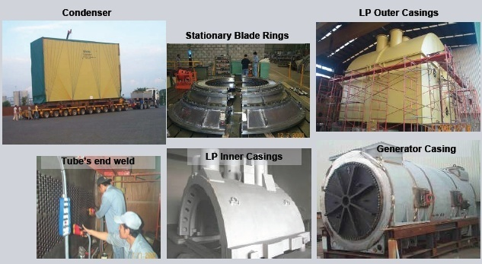
National Industry Capability
Source : PT. Siemens Indonesia
Cilegon Factory
This component for Olkiluoto NPP, Finlandia
Notes:
19

Slide 20
Status of National Nuclear Power Infrastructure Development
BATAN requested the IAEA to perform an Integrated Nuclear Infrastructure Review (INIR) Mission under the framework of TC programme (INS/4/037) in a letter dated on 5 August 2009.
An INIR mission provides an external peer reviews conducted by the IAEA in November 23 – 27, 2009
INIR mission shows that Indonesia has done extensive preparatory work on most infrastructure issues that would allow the country to make decision to further consider introduction of nuclear power, i.e. to go from phase 1 to phase 2 in Milestone methodology.

Slide 21
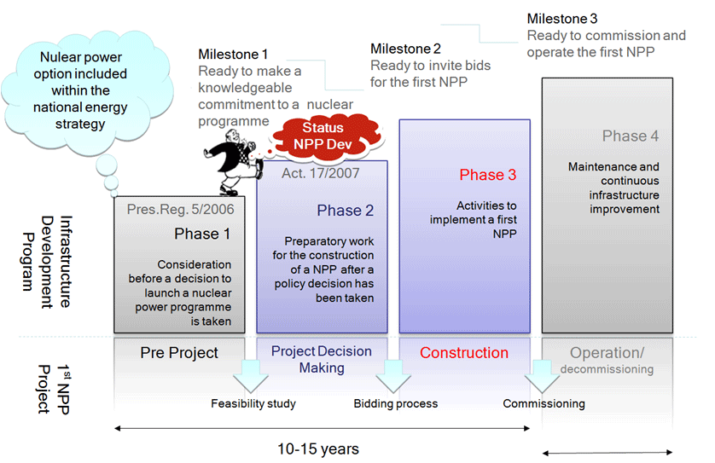
Nuclear infrastructure status

Slide 22
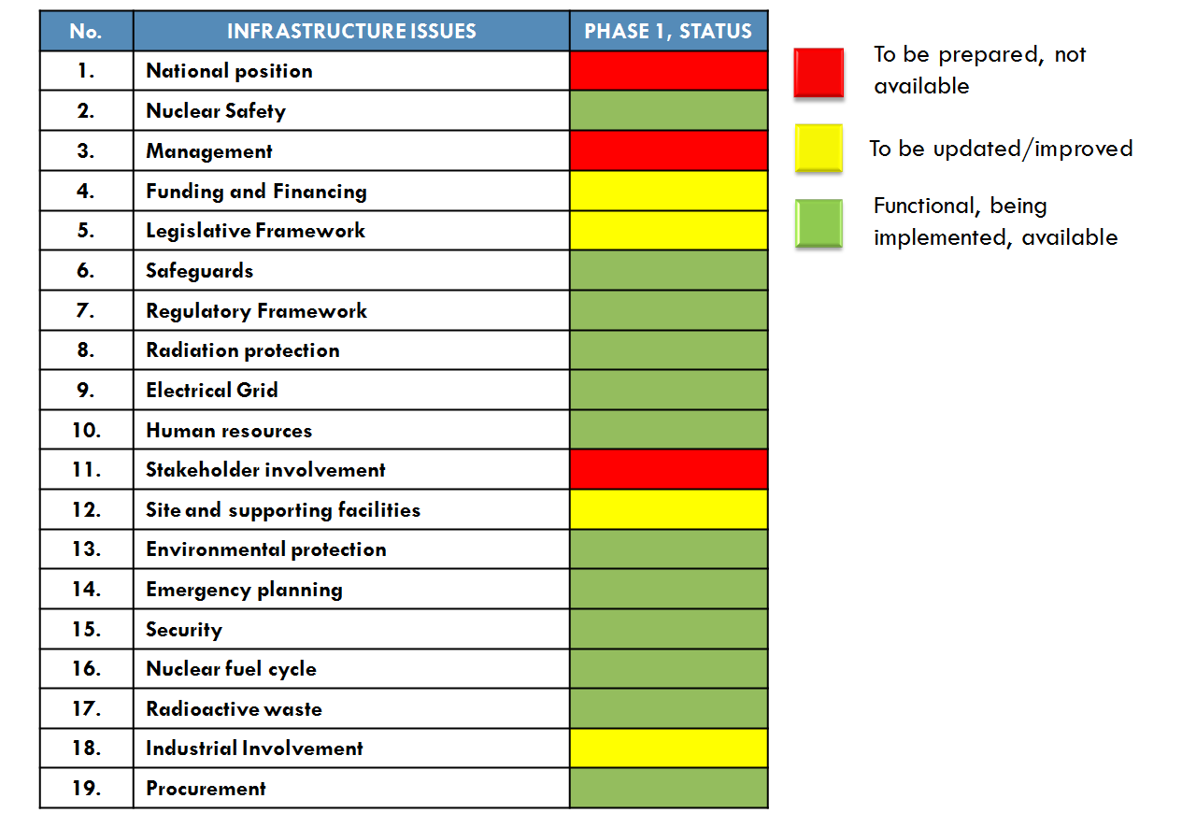
Status of nuclear infrastructure
NEPIO not yet
established

Slide 23
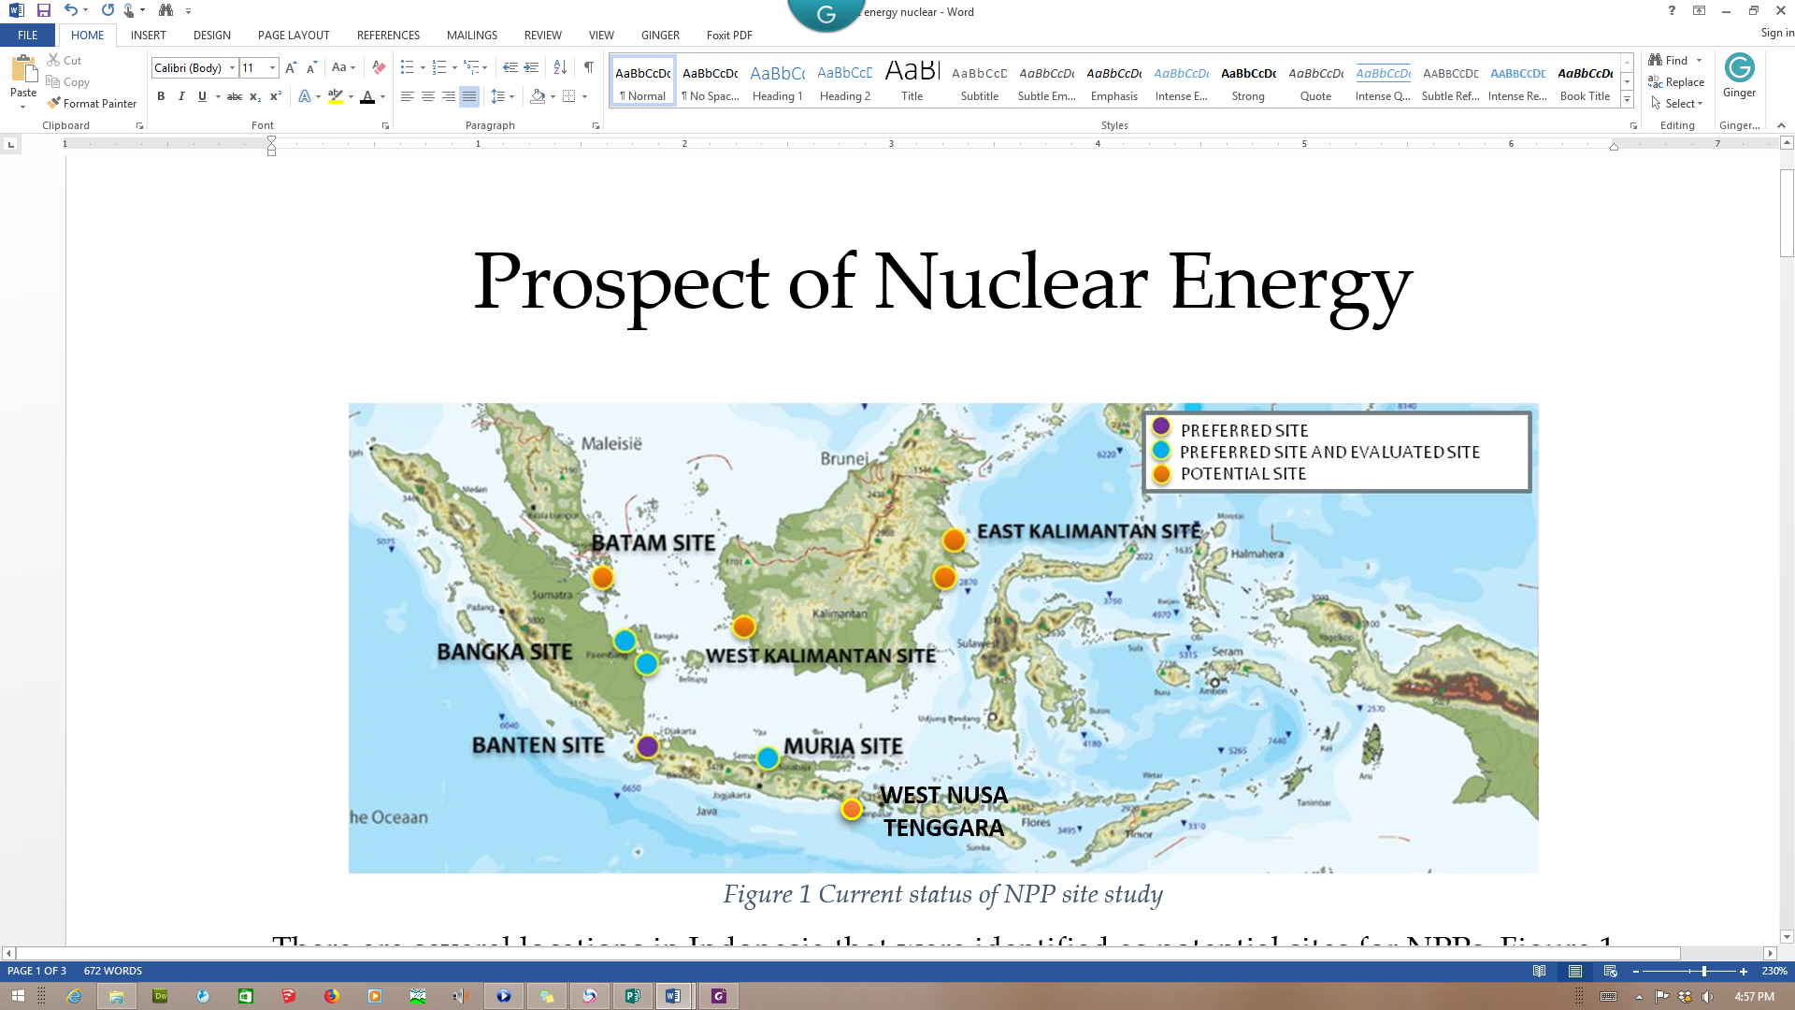
Site Study for NPP
Associated with the preparation of NPP site, there are several locations in Indonesia, which has been identified. The sites are located in the Muria peninsula, Banten, Bangka Island, East Kalimantan, West Kalimantan, Batam and Nusa Tenggara Barat. Bangka candidate site is most ready to be built NPP.

Slide 24
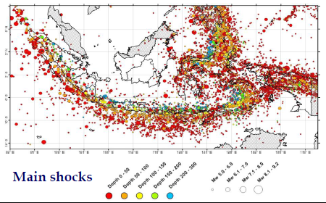
EARTHQUAKE
Notes:
Kalimatan Barat baru ada 3 kali kejadian gempa

Slide 25
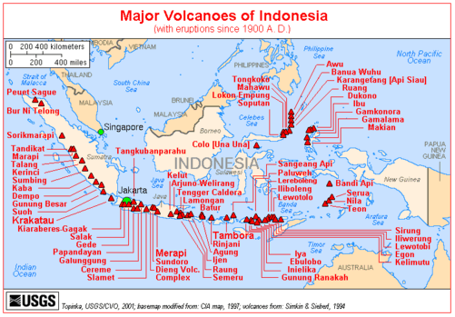
VULCANO
Notes:
Tidk ada gunung api

Slide 26
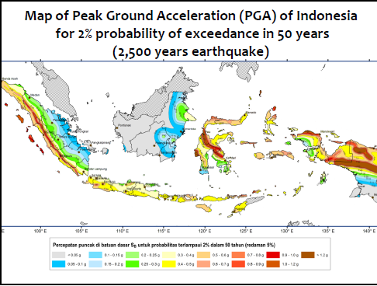
PEAK GROUND ACCELERATION (PGA)
PGA ≤ 0.6
(Masyhur Irsyam, 2010)

Slide 27
Challenges
High capital cost of nuclear power plant, less competitive compare conventional power plant
NPP is the last option (Gov. Reg. 79/14)
NIMBY, NOT IN MY BACKYARD
NIMET, not in my election territory

Slide 28
Criteria for Nuclear Energy
Based on the National Energy General Plan, nuclear can be utilized with some criteria such as:
  For fulfilling the needs of growing energy demand by supplying national energy in a large scale
  Reducing carbon emissions
  Economic competitiveness (NPP electricity selling price ≤ 7 cent/kWh - the Amount of Cost of Generation Provision (BPP) as basis for Power Purchase Agreement)

Slide 29
PUBLIC ACCEPTANCE ON NPP
Fukushima NPP Acc
Annual public opinion is conducted to measure public acceptance on NPP program;
The results within 6 years show dynamics of acceptance, especially effected by Fukushima Daiichi accident in 2011;
2016 result showed public confident tends to show increasing trends for the last 4 years.
29

Slide 30
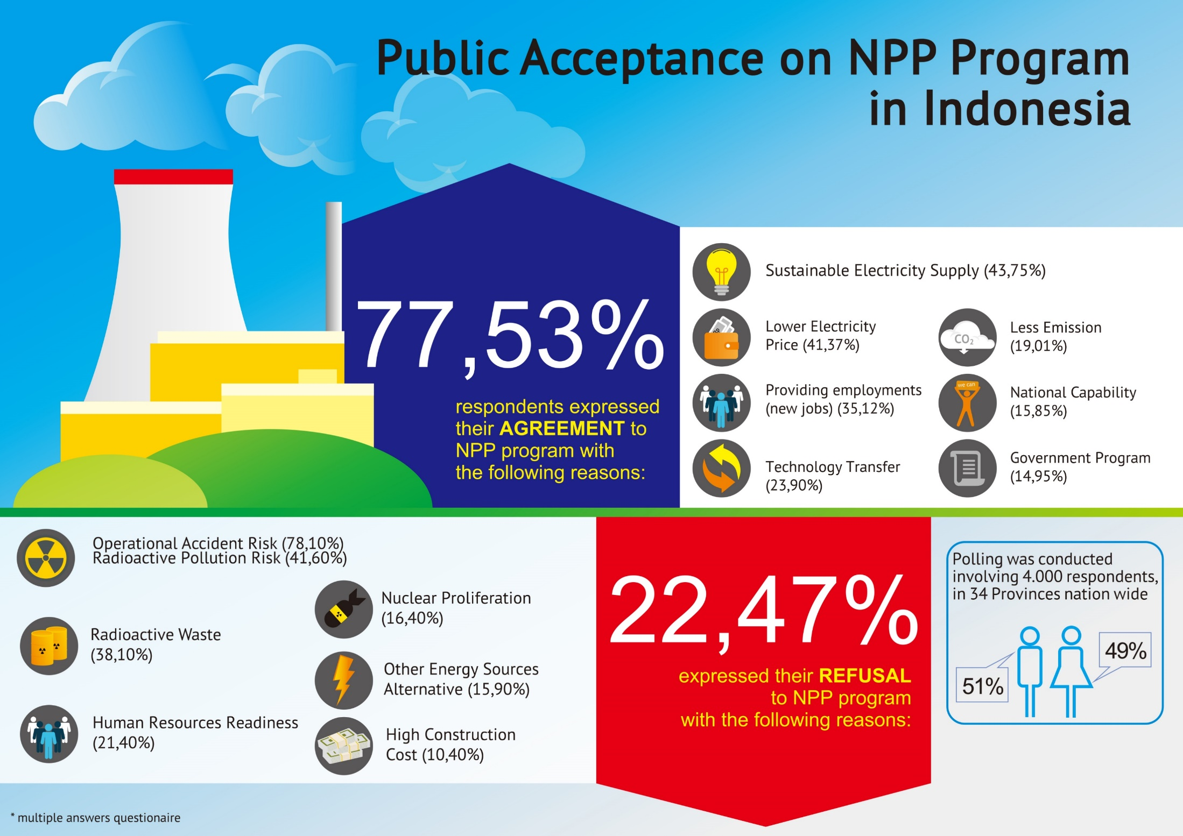
Survey period: Nov-Dec 2016
4,000 respondents
30

Slide 31
NOT IN MY BACK YARD (NYMBY)
Site Candidate
Bangka Belitung
Year | Agree (%)
2011 | 35
2012 | 28
2013 | 42.3
2014 | 56.5

Slide 32
Policy and Strategy (1)
To encourage the local Government to speak out more strongly on the need of nuclear energy.
  East Kalimantan
  West Kalimantan
  Bangka-Belitung
  Batam island
  West Nusa Tenggara
To support the Ministry of Energy and Mineral Resources on the establishment of nuclear energy roadmap.

Slide 33
Policy and Strategy (2)
BATAN’s role as promoting organization, technical supporting organization (TSO), and clearing house.
In cooperation with other stakeholders to initiate the action program on the social, culture, and politics issues.

Slide 34
FUTURE PLAN

Slide 35
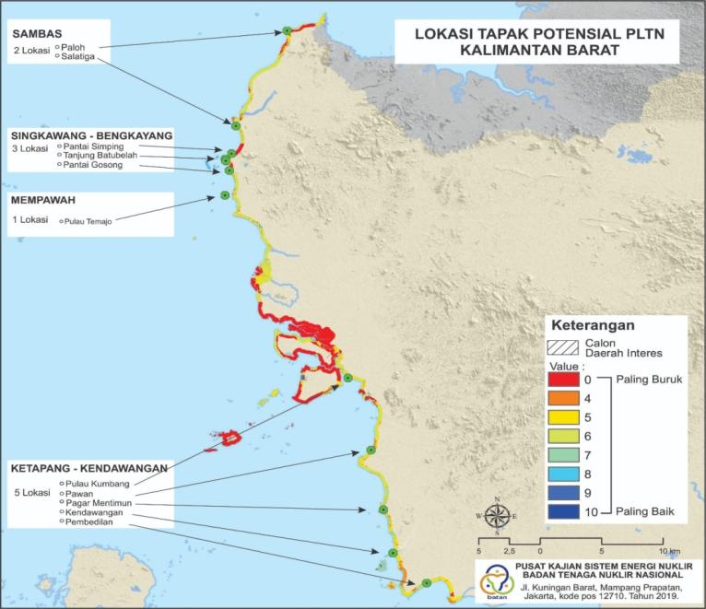
Feasibility Study (2020-2022)
National Priority Research Grant, title: PROTITYPE OF COMMERCIAL SCALE SMR
Site: West Kalimantan

Slide 36
COLABORATION SCHEME
  BATAN: PKSEN, PTKRN, PTKMR, PPIKSN
  BAPETEN
BMKG
PSG – MEMR
PVMBG – MEMR
P3GL - MEMR
INFRASTRUCTURE FOR COMMERCIAL SCALE NPP PROTOTYPE
SITE EVALUATION
REACTOR AND FUEL TECHNOLOGY
FEASIBILITY STUDY
HRD PREPARATION
DISSEMINATION AND STAKEHOLDERS ENGAGEMENT
REGULATION AND ORGANIZATION
  BATAN: Pusdiklat, STTN, BSDMO
UGM, ITB, UNTAN
  West Kalimantan Government
  BATAN: BHHK
  BAPETEN
  BATAN: PTKRN, PRFN, PTBBN, PTBGN, PTLR, PSMN
BPPT
BAPETEN
INDUSTRY
  BATAN: PDK
West Kalimantan Government
UNTAN
LIPI
  BATAN: PKSEN, PTKRN
PT Indonesia Power
UGM, ITB, UNTAN
  West Kalimantan Government

Slide 37
FUTURE PLAN
To asses NPP technology development on economic and safety aspects
Encouraging mastery of nuclear power technology in line with the latest developments in nuclear power technology developments in the world
Building international cooperation related to the study of nuclear power plant development
Ministry of Research, Technology and Higher Education/BATAN
Ministry of Research, Technology and Higher Education/BATAN
Ministry of Energy and Mineral Resources

Slide 38
FUTURE PLAN
Conduct a multi-criteria analysis of nuclear power plant implementation including: balance of energy supply, reduction of carbon emissions, safety factors and economical aspects by involving various stakeholders
Prepare a roadmap for nuclear power plant implementation as the last option in national energy development priorities
Ministry of Energy and Mineral Resources
Ministry of Energy and Mineral Resources

Slide 39

Terimakasih

