Slide 1
Industrial Involvement Policy
IAEA National Workshop on Industrial Involvement
25-27.2.20, Jakarta, Indonesia
Leena Jylhä, COO, FinNuclear Ltd

Slide 2
Outline
Introduction
Drivers and benefits
Considerations
Case Finland
Introducing nuclear energy - with policy
New nuclear builds 40 years later – no policy
Lessons learnt
Nuclear industry coordination organization
Position and role
Examples

Slide 3
Drivers of the Industrial Involvement Policy
Short-term:
Employment
Public acceptance
O&M, modernizations
Nuclear waste management
Long-term:
Employment
Public acceptance
Importance in the energy mix; secured operation
Availability of skills
Availability of spare parts
Logistics
Self-reliancy
Spin-offs sought
Construction
Decommissioning
Planning
Major entry point for local suppliers

Slide 4
Industrial Involvement Policy, Benefits
Policy
Trust of industries
Investments on development
Competitiveness
Local share up
Skills up
Economical impact, secured o&m
Exports
References

Slide 5
Considerations
Capacities of the existing industry
Industrial standards in use
Qualifications
Safe and efficient use of the plants
Availability and need of local support
Economical impact sought
Employment
Skills
International networks (multinational projects)
Following life-cycle projects
Modernizations
Nuclear waste management
New builds
Spin-offs sought
National interest/ability to invest in R&D
Assessment of needs in the long run
>> Strategy and Policy

Slide 6
Case Finland

Slide 7
History behind the Finnish Nuclear Industry
Finland was a poor country until 1960ies
Civil War 1918 and World War II 1939-1944
Broad industrialization began sparked by the reparations that Finland was forced to pay to the S.U. (*
Strategic goal since the late 1940s: high level of self-sufficiency in energy production → nuclear energy was introduced into the energy mix
Atomic Energy Commission, similar organization to NEPIO (Nuclear Energy Programme Implementing Organization) was established in Finland in 1957, and preparations started
Large supply chain of manufacturers was ready (*
Whole new industry, nuclear, was developed
Nuclear energy boosted transition from the agrarian society into modern industrial society
Notes:
Back in 1970ies the nuclear programme was truly a national effort.

Slide 8
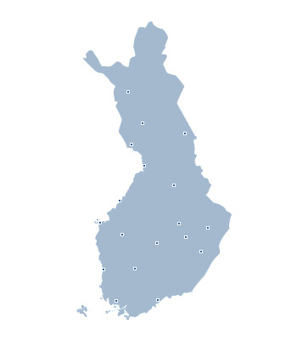
Nuclear Energy Facilities in Finland
About 30% of electricity is produced by nuclear technologies.
Even more when OL3 will be connected to the grid.
Terrafame, uranium recovery (small scale)
Fennovoima:
Hanhikivi 1
TVO: 2 x BWR 860 MW
Olkiluoto 1
Olkiluoto 2
OL3 – EPR, 1630 MW
Posiva:
Spent fuel repository ONKALO
ITER test platform, DTP2
SMR research reactor
Fortum:
2 x PWR 488 MW
Loviisa 1
Loviisa 2

Slide 9
Fleet of first 4 units in 1970ies
Loviisa 1-2: split package
Connected 1977 and 1981
Owner – architect engineer
Reactor and turbine: Russian
Other components: Westinghouse, Siemens, also a lot from Finnish manufacturers
Olkiluoto 1: turn-key
Olkiluoto 2: semi turn-key
Buildings and BoP by local companies
Connected 1978 and 1980
High domestic share during the construction, following O&M phase and nuclear waste management
Notes:
Back in 1970ies the nuclear programme was truly a national effort.

Slide 10
National Nuclear Industry Landscape Today
Ministry of Economic Affairs and Employment
MEAE - Prepares licence decisions, drafts proposals to improve legislation and steers the planning and imple-mentation of nuclear waste management. The State Nuclear Waste Management Fund is connected.
Radiation and Nuclear Safety Authority
STUK - Responsible organization for regulations and supervising radiation and nuclear safety
Licencees
Fortum, Teollisuuden Voima, Fennovoima – NPP operators. Posiva – expert organisation responsible for the final disposal of spent nuclear fuel of the owners.
Supply Chain
Engineering, consulting, some manufacturing still, site service, inspection and testing companies
RDI
VTT Technical Research Centre of Finland, GTK Geological Survey of Finland and universities with nuclear technology focus.
Others
Finnish Nuclear Industry Association (FinNuclear), Technology Industries, Energy Industries etc
Notes:
Kuva selkeämmäksi!

Slide 11
New Builds 2003 - 1/2
Many new nuclear projects were planned
Olkiluoto 3
Olkiluoto 4, Loviisa 3, Hanhikivi 1
Onkalo
Long gap since the last new builds
Assumed localization ratio 50% and private investments- no policy established
Statement regarding the Governmental Decision in Principle given to Hanhikivi- 1 and Olkiluoto 4 (cancelled later) says that use of domestic competencies in new NPP projects is expected

Slide 12
New Builds 2003 - 2/2
Olkiluoto 3: turn-key
Areva-Siemens
No major components or systems procured from Finland
Locally under 30% (even being an ”old” nuclear country):
Miscellaneous sub-components in lower safety classes
Plenty of local work-force employed
Inspection services
Engineering and design services
HSQE –management, QA-support
Site services: welding, installation, scaffolding, site supervision, logistics etc
Huge economical impact regionally though
Not much of safety-classified supplies
Some local companies had invested significantly
Hanhikivi 1: turn-key
Rosatom (RAOS Project Oy)
NPP –vendor is also a co-owner and investor
Expected localization rate similar to OL3; could be more though
Posiva Spent Nuclear Fuel Repository: multi-package
Developed by and for domestic NPP owners
Expected high domestic share in construction

Slide 13
Figures from Regional Impacts
Hanhikivi-1
Number of workers and professionals during construction
NPP will directly employ some
Source: Study of Hanhikivi-1 NPP project economical impacts
Additional new jobs will
be born on education, training and services
Peak number at the site at the same time
persons. Indirectly job creation is about
75% regionally
25% to the rest of the country
Tax benefits will be significant
Not much demanding supplies though.
If the strategy is to obtain new skills, competencies and knowledge and/or
to secure the self-reliancy over the life-cycle, industrial involvement policy with associated resources is a must
Olkiluoto 3:
Unemployment rate significantly down
Regional companies turnover +50-100%
Creation of new jobs, internationalization

Slide 14
Nuclear Industry Involvement Coordination Organization
© FinNuclear All rights reserved

Slide 15
Position and Role
Industrial Involvement Policy could include establishing such a structure
Potential implementing organization regarding industrial development actions and supporting involvement
National nuclear industry coordination organization may support the local supply chain in many ways (ref.IAEA publication)
Studies, surveys, information sourcing
Networking, matchmaking
Joint marketing
Training
RDI activities and –facilities
Results require proper resourcing

Slide 16
Benefits
Joint, systematic, coordinated (and therefore more efficient) development actions
Brings industries together
Particularly for the SMEs it may be cost saving
Governmental RDI funding may be channeled unbiased way to the industries
Increasing competitiveness by having adequate skills
regulated nuclear safety framework
requirements of EPC contractor/high tier suppliers

Slide 17
Example Finland: FinNuclear
FinNuclear
Nuclear industry specific platform
Contacts with nuclear stakeholders
Supply Chain Development
E-learning
Training courses
Information Services
www.finnuclear.fi
Newsletter
Guidebooks, surveys
Networking and Marketing Support
FinNuclear Directory
Supply chain events
Finnish expo pavillions
Delegations
Business partners
Developing joint offerings
Pre-audits
GOAL:
Competitive nuclear industry cluster to support the life-cycle of Finnish NPPs and to participate projects abroad

Slide 18
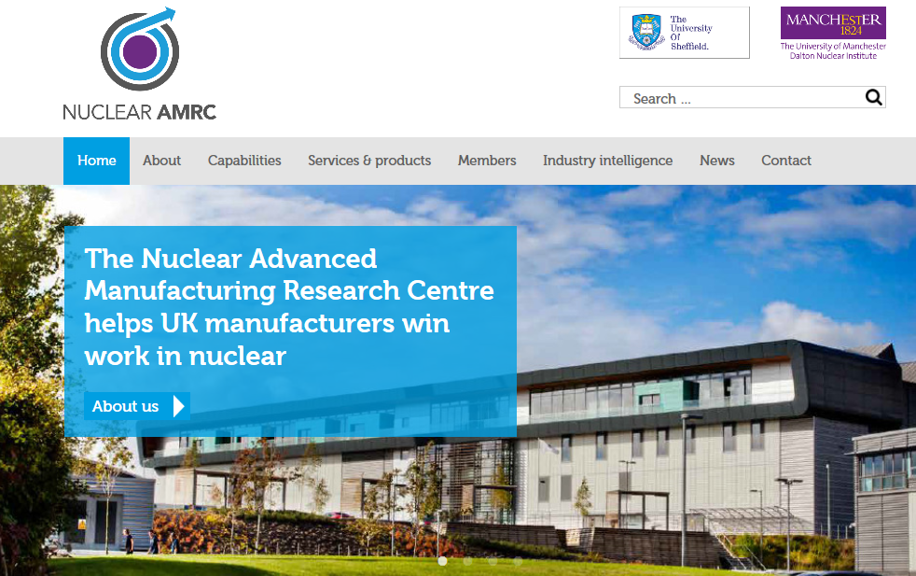
Example United Kingdom: NAMRC and NIA

Slide 19
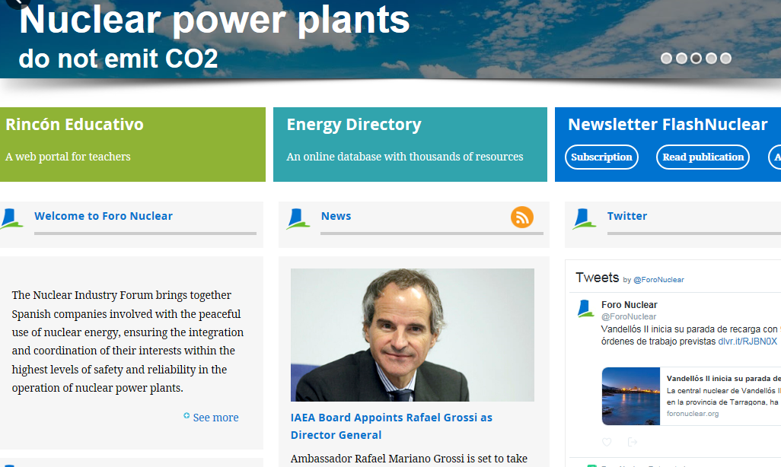
Example Spain: Foro Nuclear

Slide 20
Action Plan - Example
Action | Outcome
Study of industrial competencies | Defined existing competencies on technologial fields that NPP programme requires, key companies
Gap analysis | Defined missing competencies reflecting the regulatory framework and requirements in various safety classes
Setting realistic target | Preliminary idea of supplies that local industries could aim to. Planned potential to increase by technology transfer or strategic partnerships.
Survey of industrial interest | Companies´ interest to participate nuclear programme and invest in developing the needed competencies
Establishing joint forum to provide: | Getting local companies under one umbrella for joint visibility and shared costs
Training | Joint efforts to overcome the gaps
Networking opportunities | Establishing connections toward the clients, partners. Obtaining information.
Alliances | Increasing competititiveness
Information sourcing | Increasing awareness of the global nuclear industry field

Slide 21
Thank you!

