Slide 1

Mapping Capacity of Local Industry to Support NPP Project in Indonesia: Current Status
Arie Rahmadi-BPPT
25 Februari 2020
Notes:
Honourable
Distinguished Ladies and Gentlemen,
Good Afternoon.
First, may I introduce myself, my name is Marzan Aziz Iskandar, the chairman of the Agency for the Assessment and Application of Technology (BPPT), Republic of Indonesia.
It is my honour to attend and to meet you all in 10th Biomass-Asia Workshop in Bangkok,
Let me express my great appreciation to the organizing committee for inviting me to share information on “Opportunity and Challenge of Biomass Utilization for Energy in Indonesia”.
I hope after this session, we will have fruitful discussion for achieving our mutual benefits, particularly for our collaboration in science and technology between Asian countries.

Slide 2
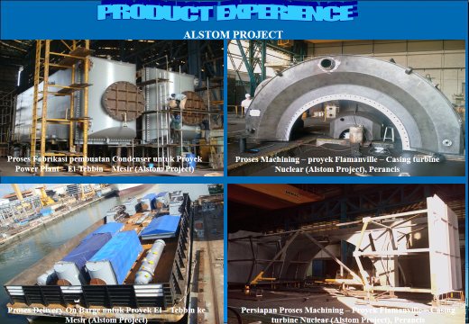
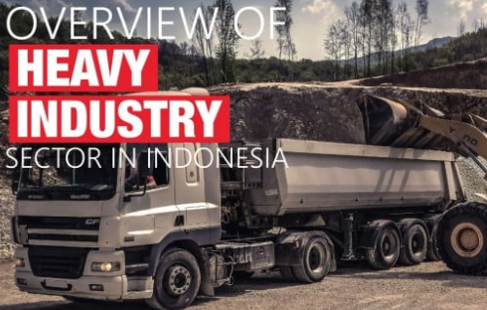
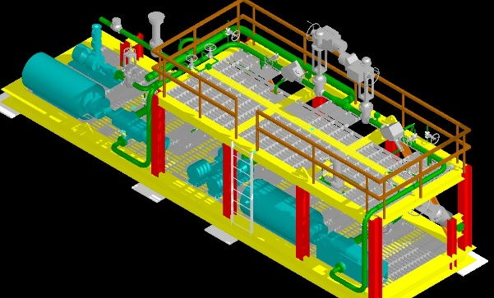
OUTLINE
1.
Background
3.
Future Work
2.
Current Mapping resuts

Slide 3
1.0 Background
Mapping for Indonesian Industrial capacity to support Electricty project has been carried out since the inception of 35.000 MW in 2014
Improving local content is viewed as realistic effort to reduce our import and providing employment opportunities
Business Plan PT PLN has shown that More Power Plant under 100 MW will be built.
Private firm through IPP will play major role

Slide 4

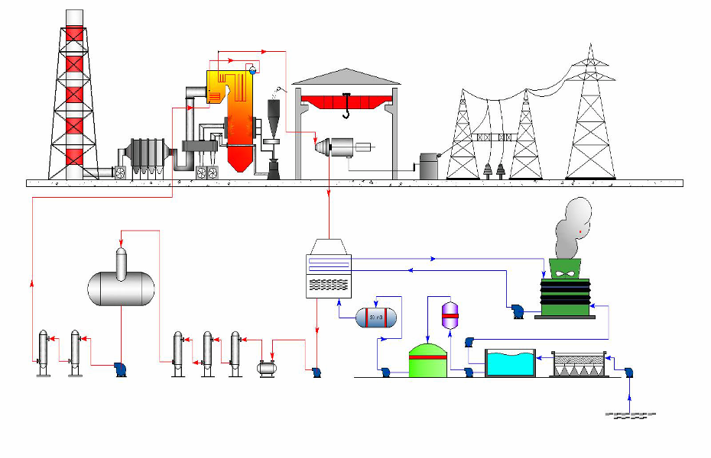
General Schematic Thermal Power Plant
CHIMNEY
Reactor BOILER/Steam Generator
TRANSMISSION TOWER
COAL
SILO
SWITCHYARD
ESP
TURBINE
TRAFO
I.D. FAN
F.D. FAN
P.A. FAN
COAL
PULVERIZER
GENERIK
DEAERATOR
COOLING TOWER
CONDENSER
WTP
1. R/O -PLANT
2. DEMIN PLANT
50 m3
BOILER
MAKEUP
WATER TANK
CW PUMPS Q = 13496 m3/h
RIVER WATER
INTAKE PUMP
2x350 m3
HP HEATER
1 & 2
BOILER FEED PUMP
Q = 360 m3/h
LP HEATER
1, 2, 3
GLAND STEAM CONDENSOR
CONDENSATE PUMP
Q = 250 t/h
TREATED RIVER
WATER BASIN
RIVER WATER
TREATMENT PLANT
DEMIN WATER
STORAGE TANK
RIVER

Slide 5
Nuclear Power plant as a solution
The Advent of SMR, Nuclear Power Plant may compete with other based load power plants
Available Technologies:
Hitachi GE, NuScale, ACP 100, Thorcon etc

Slide 6
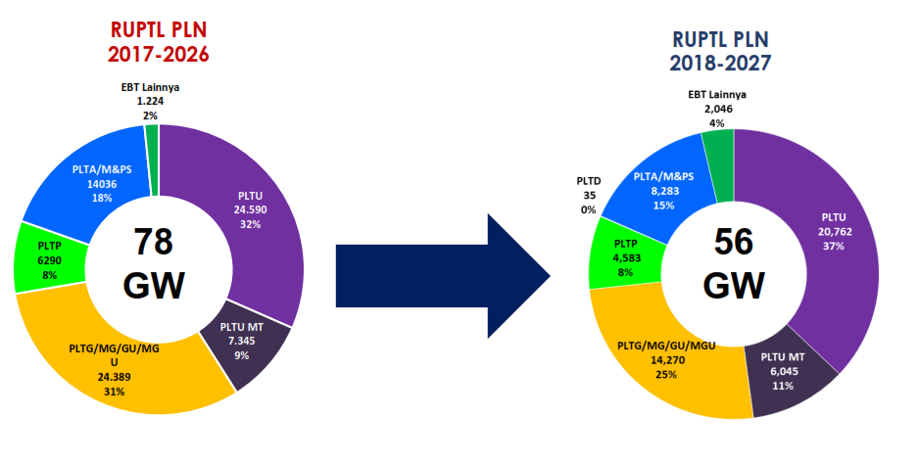
Capacity per Unit Size RUPTL 2016-2025
Number of Unit per capacity classs
PLT lain : PLTBM, PLTB, PLTS, PLTSa
Unit
Perbandingan Kebutuhan Tambahan Pembangkit 2017 - 2018

Slide 7
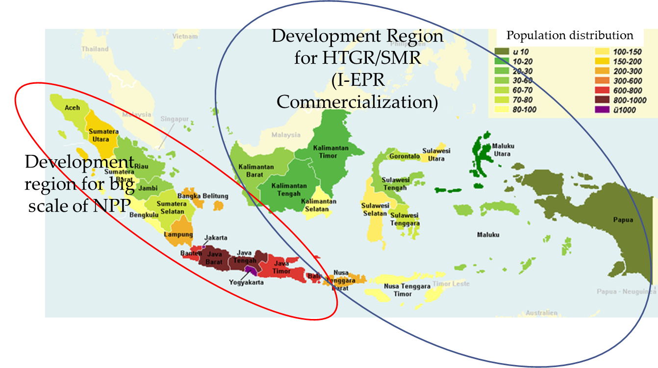
Potential Location for NPP Deployment in Indonesia
Bangka Site,
Status FS Finished
(2011-2013)
West Kalimantan Site,
Site Survey
Large scale NPP can be developed in Sumatera and Jawa.
SMR (Small Modular Reactor) can be develop in Eastern part of Indonesia, after commercially proven.
East Kalimantan Site,
Site Survey
Banten Site,
Status: Under study (2008-2017)
Muria Site,
Status: Had been evaluated (1991-1996),
Now: monitoring of meteorology and micro seismic
Source: BATAN

Slide 8
At least 100 unit <100 MW equal to a business of Rp. 1000 T in ten years to 2025
The Case for SMR
Market for power plant per unit size
Number of Unit per capacity classs
Unit
Economic benefit
Job Creation , foreign exchange saving (Rp 250T)
Secondary benefit Rp 500T (Steel Industry, Civil, instrument, piping, services, etc)
Niche Market (Renewables)
Wind Power
PV
MSW Poer Plant
Biomass Power Plant
Nuclear

Slide 9
Construction of Power Plant
Feasibility Study
Project Development, permit
and Design (Engineering)
Construction and
Procurement
Start-up &
Commissioning
Supervision & System Integrator
7
1
2
System
Detail Design
3a
4
5
6
Conceptual
Design
Basic
Design
Procurement
/Fabrication
Installation
/Construction
Start-Up &
Comisioning
Detail
Engineering
Design
EPC
(Engineering Procurement & Construction)
3b
Civil and Structure
Steam Generator
Turbine & Generator
I&C
Electrical
Reactor Vessel
Condenser, Feed water Heater

Slide 10
OUTLINE
2.
Current Mapping resuts

Slide 11
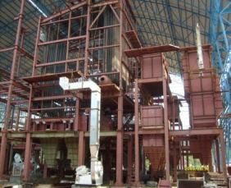
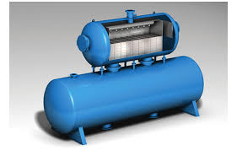
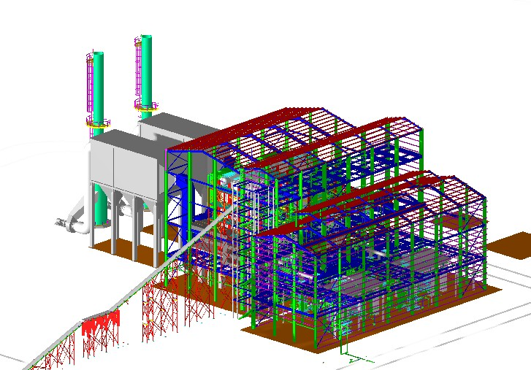
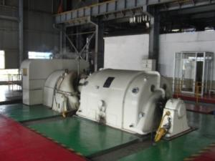
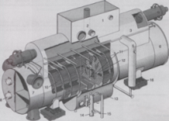
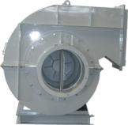
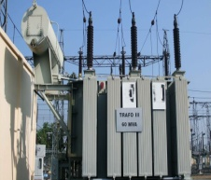
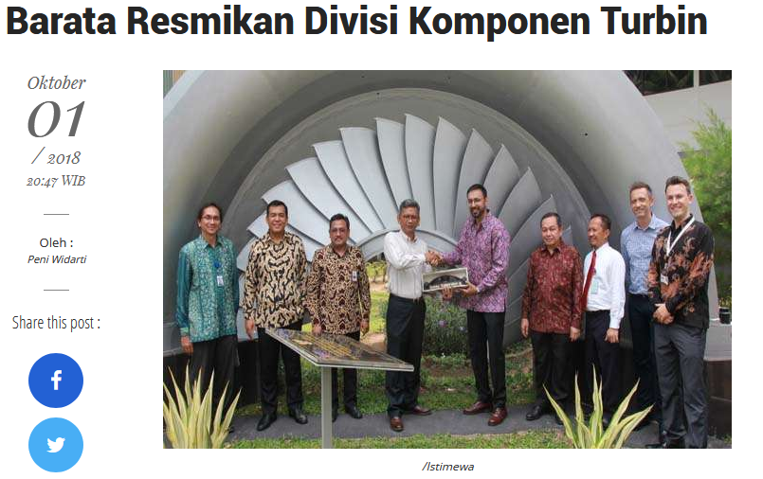
Mapping of National Industry Capacity
10 Company
IHI. GE Power
BBI, Barata,
Basuki , Zug, Atmindo, Weltes, etc
EPC COMPANY
Bobot 5%
48 Engineering Company
Rekayasa Industri, WIKA,
Dale, Truba Enjiniring etc
Boiler
Bobot 30%
Deaerator
Condensor
Turbine & Generator
Bobot 25 %
Fan, Pump, Compressor,
4 Perusahaan:Barata (Siemens Ind.)
Pindad, Sulzer, Nusantara Turbin & Propulsi, Texmaco
Balance of Plant
Bobot 17 %
15 Perusahaan
Boma Bisma Indra, Barata, ,etc
Civil
Bobot 15%
Wijaya Karya, Hutama Karya, Adi Karya, PP etc
Electrical, Instrumentation and Control
Bobot 8 %
Siemens Indonesia, Unindo, Trafindo, etc

Slide 12
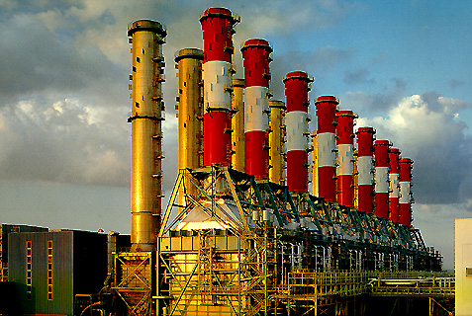

GRESIK dan GRATI COMBINE CYCLE POWER PLANT
STEAM TURBINE MACHINING & ASSEMBLY (190 MW)
STEAM TURBINE BALANCE OF PLANT
MAIN CONDENSER 3 UNITS
DEAERATOR & STORAGE TANK 3 UNITS
GENERAL SERVICE WATER COOLER 6 UNITS
LUBRICATION OIL COOLER* 3 UNITS
GLAND STEAM CONDENSER* 3 UNITS
MAIN OIL TANK 3 UNITS
DIRTY CLEAN OIL STORAGE TANK 1 UNIT
CIRCULATING WATER PIPING 883 TONNES
PLANT PIPING 1.220 TONNES
HEAT RECOVERY STEAM GENERATOR
LP DRUM 6 UNITS
GAS TURBINE BALANCE OF PLANT MANUFACTURING
AIR & OIL COOLER 27 UNITS
A & B RACK 4 UNITS
START UP UNIT 4 UNITS
INLET / EXHAUST DUCT 9 UNITS
BY PASS STACK 9 UNITS
PT PAL Indonesia supports to Mitsubishi Heavy Industries (MHI) as Co-manufacturer on providing the Balance of Plant equipment.
Sumber : Paparan PT PAL

Slide 13
PT PAL to Manufacture Turbine

Slide 14
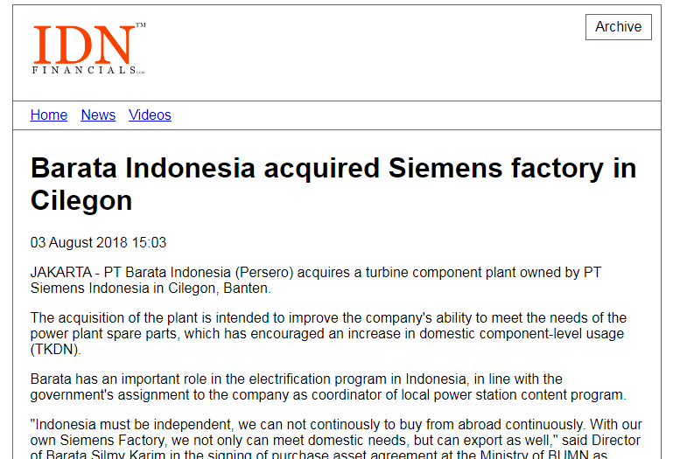
02 Dec 2014
Pabrik Siemens Cilegon Pernah Membuat Pembangkit
Listrik 1.600 MW
Pabrik Siemens Cilegon memproduksi kondensator besar dan bagian komponen lain yang siap dipasang pada turbin gas serta uap.
"Pabrik kondensator Siemens Indonesia di Cilegon termasuk pabrik terbesar di dunia, karena pernah membuat pembangkit listrik terbesar untuk pembangkit listrik di Finlandia dengan kapasitas 1.600 MW pada tahun 2007," kata kata Presiden Direktur dan CEO PT Siemens Indonesia, Josef Winter.Menurut Josef Winter, di usianya yang sudah 25 tahun, Pabrik Siemens Cilegon berjanji akan terus meningkatkan produktivitas dalam industri manufaktur lokal di tanah air. Pabrik Siemens Cilegon memproduksi kondensator besar dan bagian komponen lain yang siap dipasang pada turbin gas serta uap.
Komitmen Siemens dalam pengembangan kompetensi sumber daya manusia ini bukanlah hal baru. Tahun lalu, Siemens Indonesia telah menyumbangkan peralatan pelatihan untuk Laboratorium Kelistrikan dan Bengkel Mekanik milik Krakatau di Cilegon, Banten. Kerjasama dengan perguruan tinggi itu hingga kini masih terus terpelihara.
Saat ini, Pabrik Siemens Cilegon sedang mengerjakan “Turbin Zero”, sebuah kondensator tubrin uap untuk sebuah proyek berskala international di Arab Saudi. Sedangkan untuk pasar domestik, dirakit empat unit turbin uap berkapasitas 8,5 MW untuk Proyek PLN di Timika, Papua.
"Pabrik Siemens Cilegon juga akan memperluas portofolio produknya dengan pembuatan turbin uap kecil untuk mendukung program peningkatan daya listrik pemerintah Indonesia," kata Josef Winter. RAE.
Sumber : http://www.geoenergi.co/m/lens/4342/konpres-menteri-esdm-pembentukan-up3kn/

Slide 15


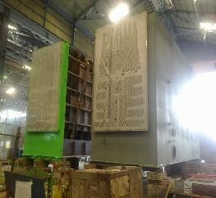
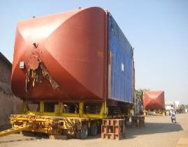
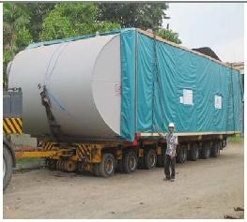
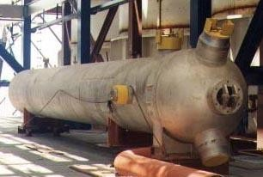
Agency for the Assessment and Application of Technology - Indonesia
Agency for the Assessment and Application of Technology - Indonesia
Agency for the Assessment and Application of Technology - Indonesia
Agency for the Assessment and Application of Technology - Indonesia

Slide 16
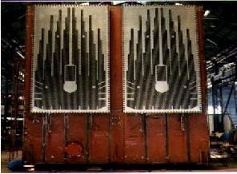
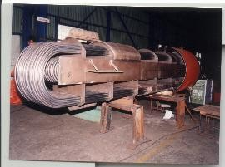
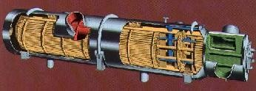
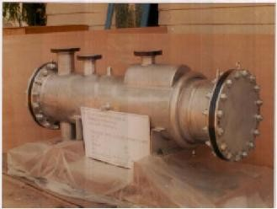
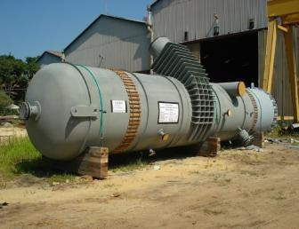
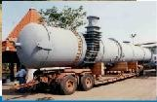
14/02/2018
PT. Boma Bisma Indra (Persero) ASME Stamp Holder S U U2 Pp
PT. Boma Bisma Indra (Persero) ASME Stamp Holder S U U2 Pp
With : TITANIUM SEAL WELDING TUBE TO TUBESHEET
Size (mm) : 7440 W x 8460 H x 9230 L Weight : 180 Ton
Customer : HITACHI M&E, Ltd., Years : 1992
Power Plant LP Heater
With : STAINLESS STELL EXPAND AND SEAL WELD
Size (mm) : Dia 1200 x 8650 L Weight : 3x45 Tons
Customer : EVANS DEAKIN ENG. AUSTRALIA
Agency for the Assessment and Application of Technology - Indonesia
Agency for the Assessment and Application of Technology - Indonesia
PT. Boma Bisma Indra (Persero) ASME Stamp Holder S U U2 Pp
PT. Boma Bisma Indra (Persero) ASME Stamp Holder S U U2 Pp
SIZE (MM) : OD 500 X L 2115
WEIGHT : 3 x 1,5 TON
CUSTOMER : TOSHIBA
SIZE (MM) : OD 2100 X L11250
WEIGHT : 3 x 23 TON
CUSTOMER : REKIN
Unocal Gunung Salak
SIZE (MM) : OD 2300 X L 20250
WEIGHT : 10 x 45TON
CUSTOMER : Flour Daniel - IKPT
Agency for the Assessment and Application of Technology - Indonesia
Agency for the Assessment and Application of Technology - Indonesia
1

Slide 17
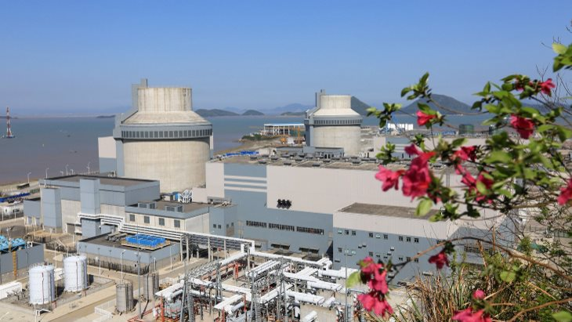
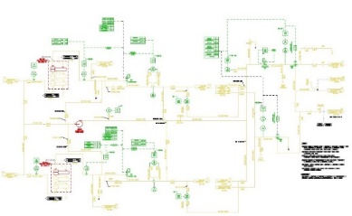

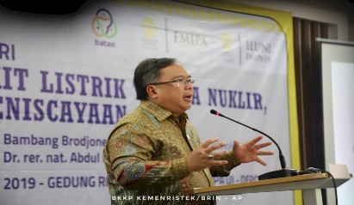
ENGINEERING EXPERIENCE IN NPP (BATAN-BPPT)
Pressurized Water Reactor (PWR)
Gen 3+ Westinghouse AP600/1000
Spent Fuel & South End Turb Bldg
Work Package: P&ID Design, CLD, Piping Layout, Isometric, Modularisation
BPPT
BECHTEL
CA, USA
Menristek: NPP has to be prepared
BATAN
INITEC
SPAIN
WESTINGHOUSE
PA, USA
ANSALDO
ITALY
SOUTHERN C.S.
AL, USA
BURNS & ROE
NJ, USA
SNERDY,
SHANGHAI
https://today.line.me/id/pc/article/Menristek+Pembangkit+Nuklir+Tetap+Disiapkan+untuk+Antisipasi-Jrw5nq

Slide 18
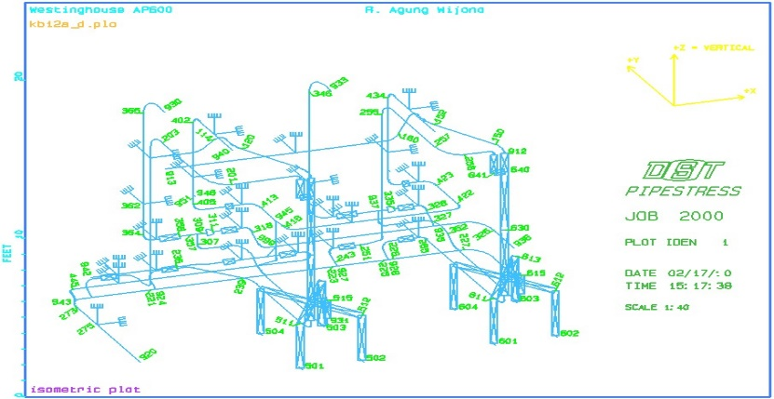
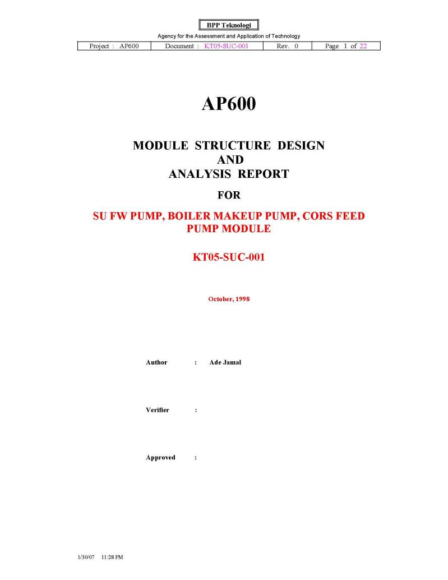
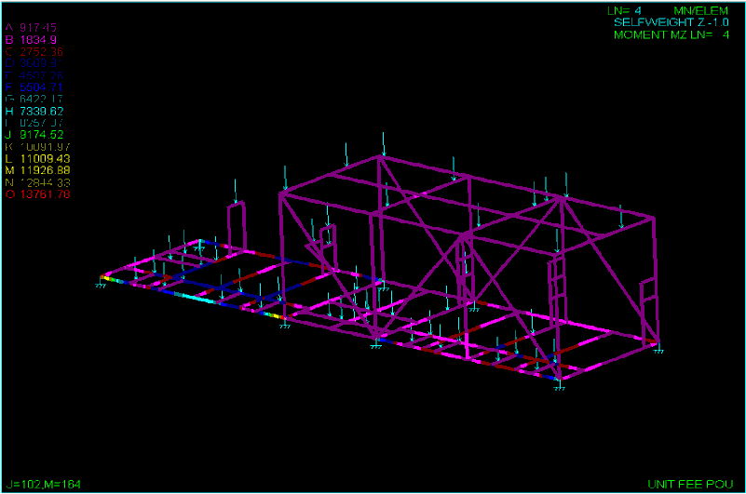
Piping and Structure Analysis
Piping and Structural stress analysis was carried to avaoid structural failures due to static load and dynamic load during transportation and operation.

Slide 19
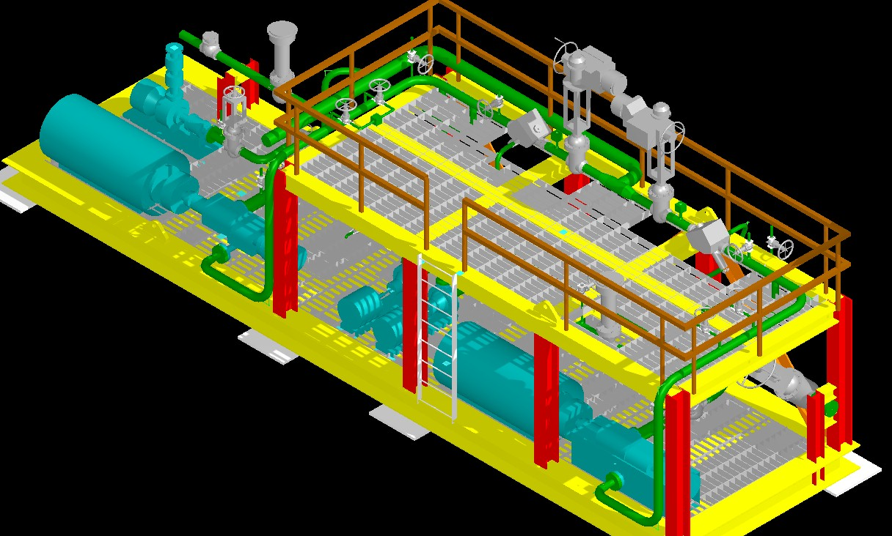
FEED WATER SYSTEM MODULE
BPPT - WESTINGHOUSE AP600/1000
Modularisation to a particular Start Up Feed Water System. It comprises all mechanical equipment, piping, structure, electrical and instrument to speed up as well as ensuring quality of work.

Slide 20
OUTLINE
3.
Future Work

Slide 21
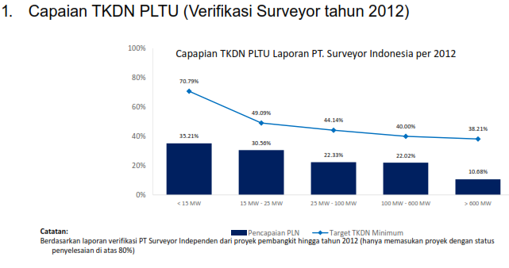
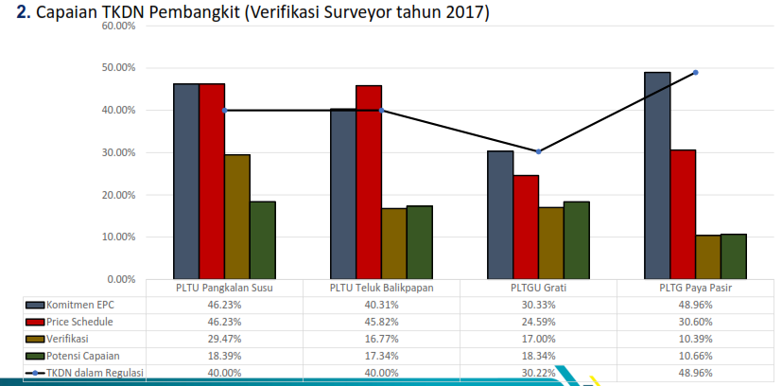
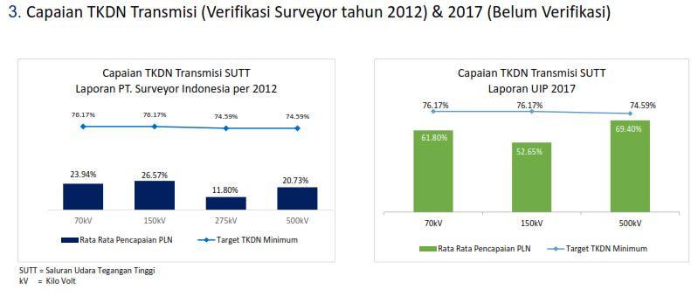
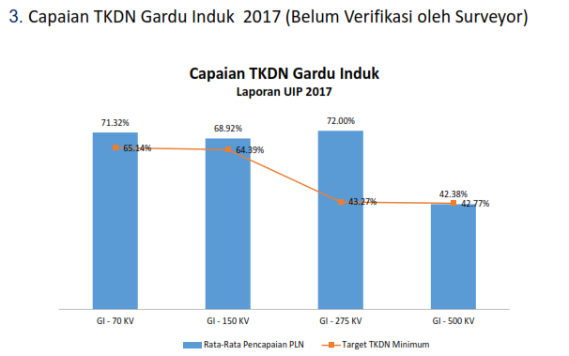
Lesson Learn: Local Contents in Power Plant Project
Source:: PLN, 2018

Slide 22
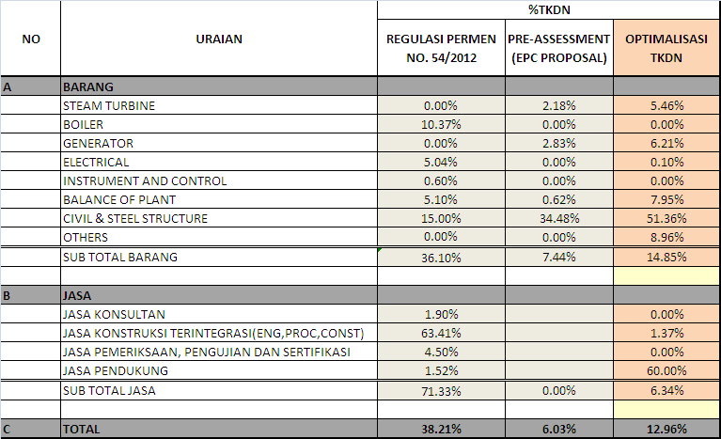
Lesson Learned: 1000 MW Project

Slide 23
Next Work
The first 2 Nuclear Islands Components and control system are suggested to be supplied from overseas reputable companies
Setting the Design Standar 100 MW NPP
Focusing on Non-Nuclear Island
  Turbine Generators
  Turbine Bldg
  Civil works and Structure
  Balance of Plants (Condenser, Feed Water Heater, Feed Water heater pumps, Crane etc)
Producing List of Equipment and Bill of Materials
Matching the Industry with List of Components

Slide 24
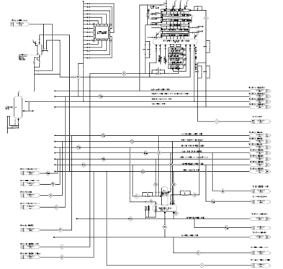
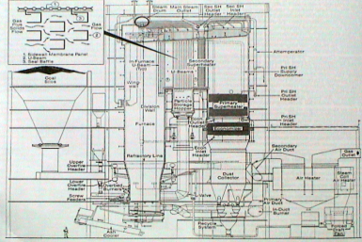
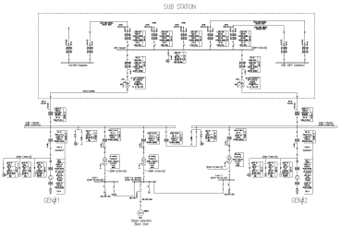
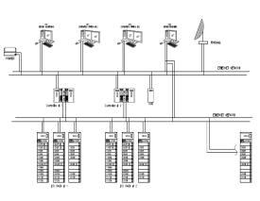
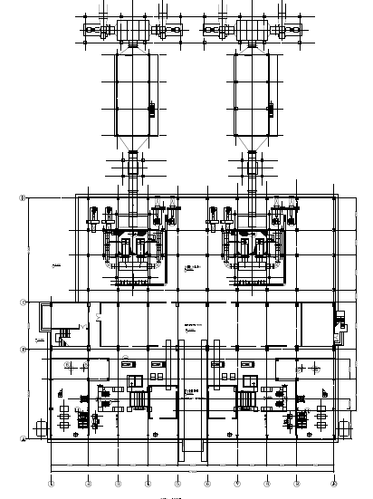
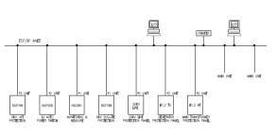
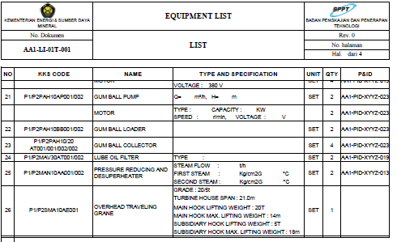
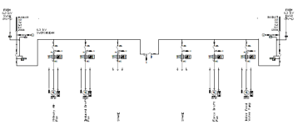
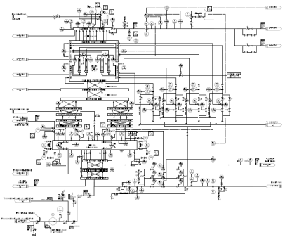
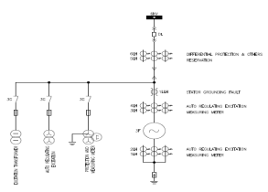
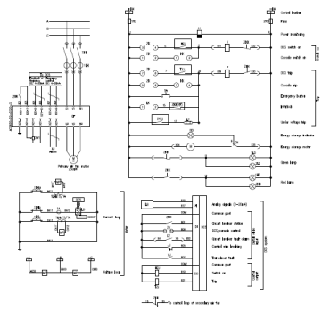
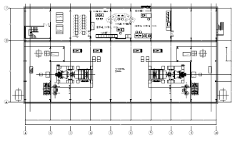








Integrated System
THERMAL | MEKANIKAL / PIPING | ELEKTRIKAL | I&C | SIPIL&STRUKTUR
100 GBR + DOK | 500 GBR + DOK | 250 GBR + DOK | 100 GBR + DOK | 200 GBR + DOK

Slide 25


Sample Condenser Design

Slide 26




Technology Acquisition: Licensing
Simple Form
Legacy
CASA License
SS-1/2/3 Inittially licensed from FN
For NPP: Though Local Industries can supply the equipment, Licensing is required to promote innovation
Ship: Licencing from Dutch Company

Slide 27

... Message …
We are competitive overseas but could not compete at home
Change

