Slide 1
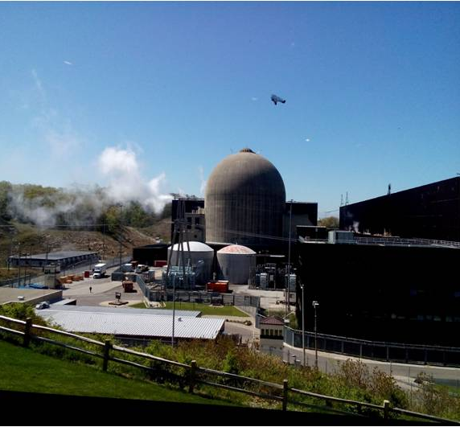
Public Acceptance for Nuclear Power in West Kalimantan
PENERIMAAN PUBLIK UNTUK ENERGI NUKLIR DI KALIMANTAN BARAT
Dr.Netty Herawaty.M.Si
SEMINAR ON JAPAN NUCLEAR POWER EXPERIENCES AND INDUSTRIAL DEVELOPMENT
Pontianak, Conference Building Tanjungpura University 10 Desember 2019

Slide 2
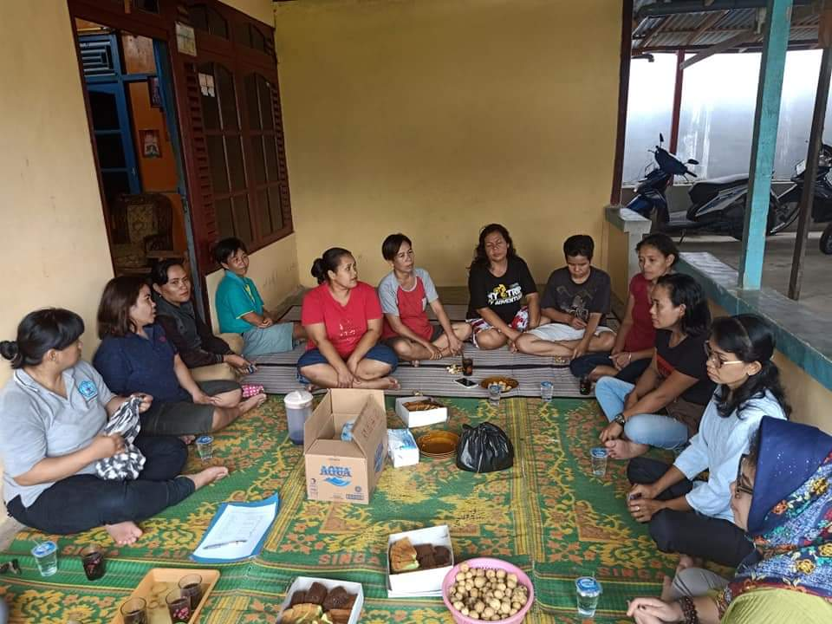
WHY IS PUBLIC ACCEPTANCE IMPORTANT IN BUILDING NUCLEAR PLANT?
- The public is the main stakeholder in the use of nuclear energy
- Public acceptance is very important in the nuclear energy program, since the planning, construction and operational phases
- Public support is needed to ensure the smooth operation of nuclear power plants
- For a democratic country like Indonesia, public acceptance will determine the decision to build a nuclear power plant
Notes:
Selama rentang tahun 2010 hingga 2018 BATAN bekerja sama dengan konsultan survey dan LPPM beberapa perguruan tinggi melakukan studi jajak pendapat dan pemetaan stakeholder untuk mengetahui status persepsi dan tingkat penerimaan masyarakat serta memetakan berbagai aspek sosial pemanfaatan energi nuklir.

Slide 3
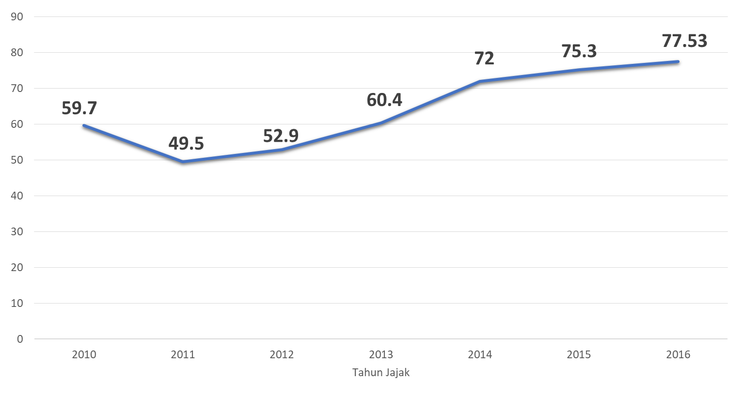
RESULTS OF STUDY IN 2010-2016 NATIONAL LEVEL

Slide 4
Distribution of Acceptance Rates in 2016

Slide 5
ACCEPTANCE RATE OF INTEREST AREAS

Slide 6
REASONS FOR DISCLAIMER BY RESPONDENTS

Slide 7
REASONS FOR ACCEPTANCE BY RESPONDENTS

Slide 8
PUBLIC ACCEPTANCE FOR NUCLEAR ENERGY
IN WEST KALIMANTAN
The toughest challenge for the government as implementor the law is how to increase the acceptability of nuclear electricity through increasing public trust
???
Until now public is still developing negative perceptions and false views related to information and knowledge about nuclear
??
Nuclear Information that provokes dialogue in Public Communication in Indonesia :
- Nuclear Power Plant accident
(Chernobyl, Three Mile island, dan Fukushima)
Danger of nuclear radiation
Concerns about the safety and security of nuclear plants
Nuclear Waste Treatment Technology
Nuclear Technology
NPP financing which is considered expensive
Concerns about corruption in the npp project and indiscipline culture in Indonesia.
Pros and cons of NPP development
- Environmental factors (seismicity) etc.
This condition originated from nuclear-related information obtained by the public since elementary school about the Atomic Bomb that destroyed Hirosima and Nagasaki and news in the mass media related to accidents

Slide 9
PUBLIC ACCEPTANCE
FOR NUCLEAR ENERGY IN KALIMANTAN
Dissemination through information and public education needs to be strengthened, so that misperceptions about the risks of nuclear hazards can change as well as growing confidence in aspects of increasing security and safety of Nuclear technology that can be relied upon, so that public support for nuclear power plant development plans will increase.
NEXT…, PUBLIC ACCEPTANCE STRATEGY IS NEEDED BY CONSIDERING COMMUNITY CHARACTERISTICS, INFORMATION REQUIREMENTS AND COMMUNICATION CULTURE

Slide 10
KALBAR SOCIAL COMMUNITY DESCRIPTION
Ethnic / cultural diversity
Dayak
Melayu
Jawa
Tionghoa
Madura
Bugis
Sunda
Batak
Banjar
dll
RELIGION
1 Islam
2. Christian / Catholic
3 Budha
3 Kong Fu Cu
4 Hindu
PENDIDIKAN
West Kalimantan's human development index is still at 66.26. Whereas the national HDI is 70.89
7.5 years of school education
Biggest Number Not Completed Elementary School And not at school> 50 percent
COMMUNICATION CULTURE
Tend to use regional languages ​​among ethnic groups.
in communicating between cultures using Malay or Indonesian.
conduct consensus agreement in making decisions in public affairs
Appreciate / respect the Speech of Cultural Figures, Community Leaders and Religious Figures. and Educator
Ethnic solidarity ties are maintained through the similarity of languages, cultural and religious attractions (Gawai, Robo-robo, Cap Go Meh dll)
Social aspects of the community are factors that need to be considered in developing a communication strategy and the socialization of a nuclear power plant development to build public understanding and public acceptance of the plan to build a nuclear power plant in West Kalimantan

Slide 11
PUBLIC COMMUNICATION PROBLEMS RELATED TO NUCLEAR INFORMATION
PUBLIC LITERATION CAPABILITIES ARE STILL LOW (RELATING TO EDUCATION LEVEL, CULTURE READING ETC.) , THIS MAKES MASS COMMUNICATIONS AND PUBLIC COMMUNICATIONS CANNOT PROVIDE INFORMATION, ADEQUATE KNOWLEDGE AND UNDERSTANDING TO COMMUNITIES. IT MAKES THE COMMUNITY YET NOT BE ABLE TO BE OBJECTIVE AND EXPRESSIVE ATTITUDE TO RESPOND NUCLEAR POWER PLANT DEVELOPMENT PLAN INCLUDING WEST BORNEO.
THIS CONDITION MAKES COMMUNITIES EASY TO MOBILIZED AND PROVOCATED BY PARTIES WHO HAVE SCENARIOS TO REFUSING NUCLEARS WITH FALSE, INVALID INFORMATIONS.
The sophistication of today's communication technology makes it possible for everyone to carry out public communication.
While the mass media does not provide a portion to display positive news related to nuclear and instead many negative, provocative news that publicize.

Slide 12
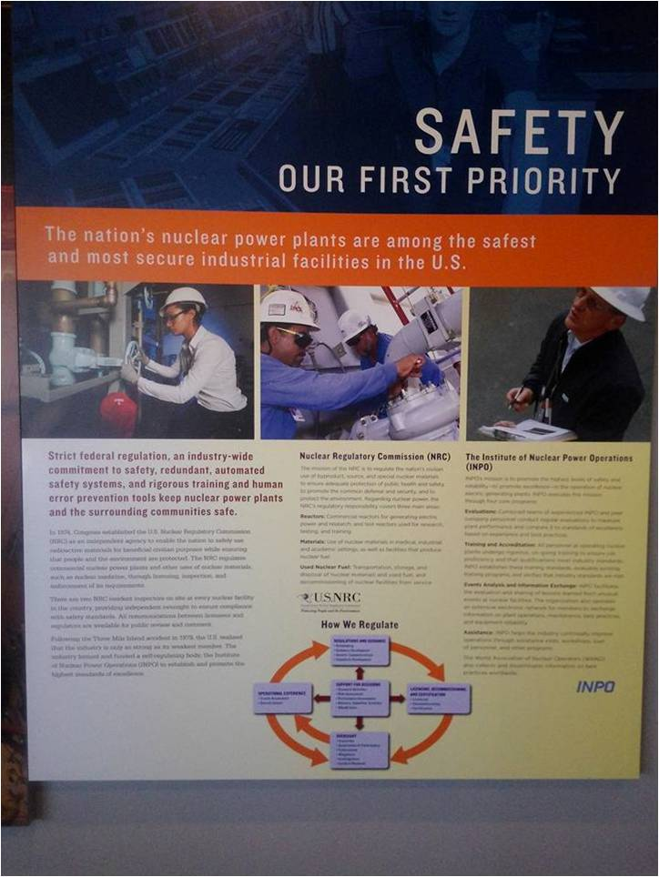
PUBLIC ACCEPTANCE COMMUNICATION STRATEGY
To Increase Participation to support the plan to build nuclear power plant in West Kalimantan
COMMUNICATOR Strategy
MESSAGE Strategy
MEDIA Strategy
AUDIENCE Strategy
Output : Public Understanding
Outcome : Public Acceptance
Participation

Slide 13
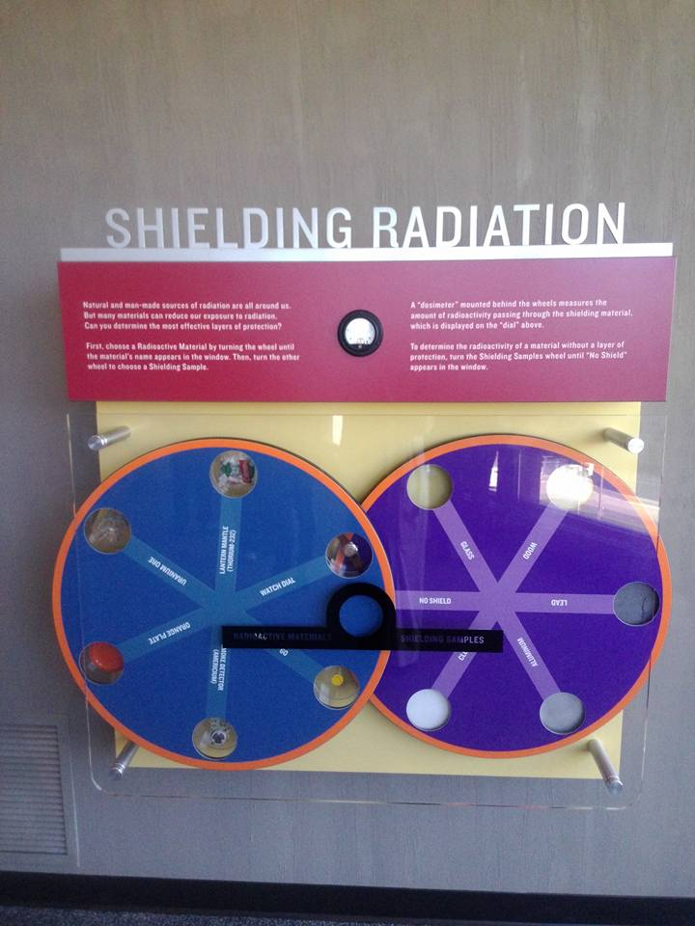
that there is a strong tendency that if more people obtain clear information about nuclear power plants, the public acceptance of nuclear power plants will be higher whereas risk perceptions will be low
that there is a strong tendency that if more people obtain clear information about nuclear power plants, the public acceptance of nuclear power plants will be higher whereas risk perceptions will be low
that there is a strong tendency that if more people obtain clear information about nuclear power plants, the public acceptance of nuclear power plants will be higher whereas risk perceptions will be low
Theory of Public Acceptance Models
T.Ohnishi (1995) and Y.S.Choi et,al (1999) who try to formulate public attitude related to the plans for the construction of nuclear plants in each country, namely in Japan and Korea.
Ohnishi's conclusion emphasizes the importance of balanced positive and negative information so that people can determine their own attitudes.
Conclusion Y.S. Choi et al
that there is a strong tendency that if more people obtain clear information about nuclear power plants, the public acceptance of nuclear power plants will be higher whereas risk perceptions will be low.

Slide 14
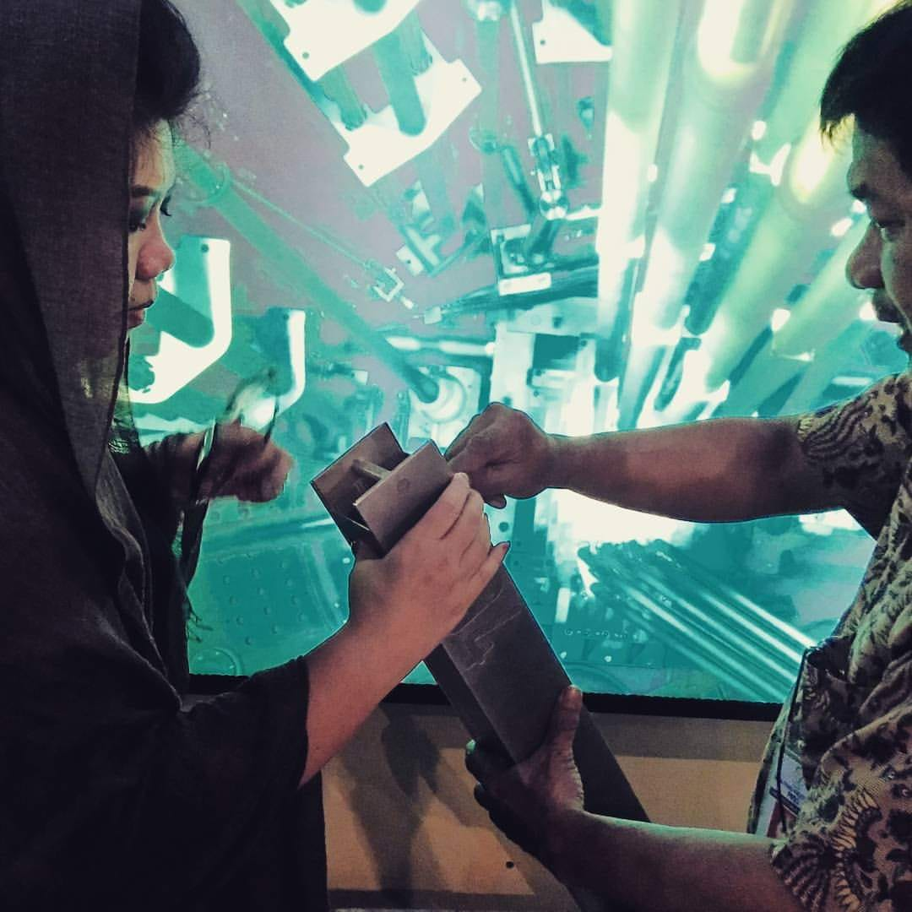
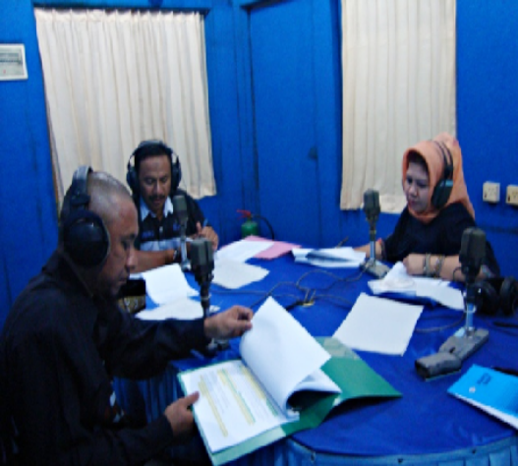
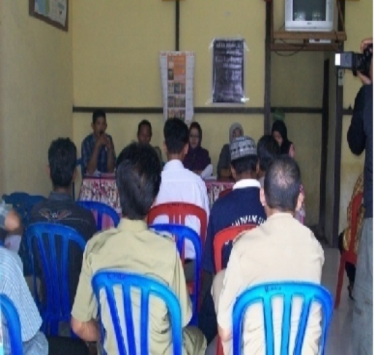
COMMUNICATOR STRATEGY
SOCIALIZATION OF KALBAR NPP
Attractiveness communicator
- The credibility of the communicator is a strong reason for the audience to change their views.
Communicators who really master the problem and good mastery, tend to be trusted by the target audience
Information communicator & public education of West Kalimantan NPP
In addition to those who really understand nuclear science and technology need to hold and make community leaders, traditional leaders, religious leaders and educators to become agents of socialization of nuclear power plants

Slide 15
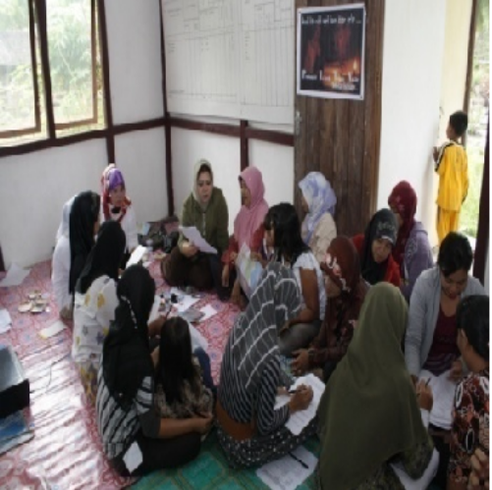
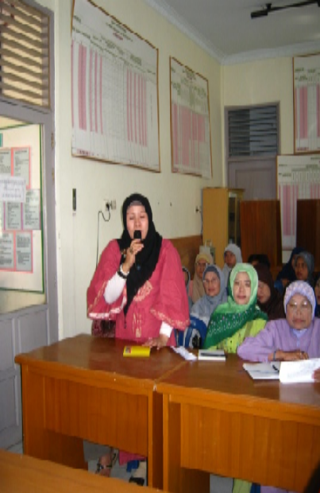
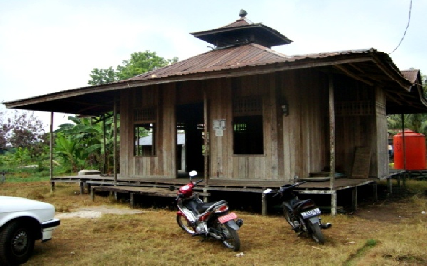
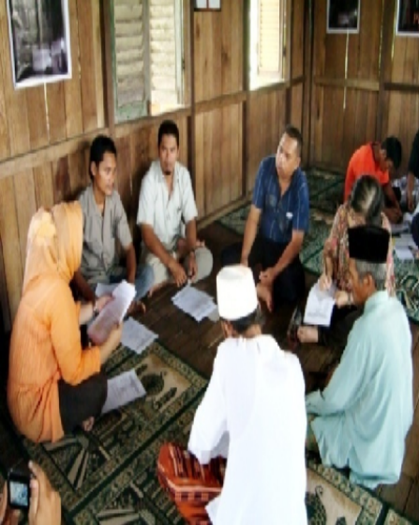
MEDIA STRATEGY FOR SOCIALIZATION OF KALBAR NPP
Filter public information and one-door coordination for publication material
- MASS MEDIA
- SOCIAL MEDIA
Face to Face: Deliberation Communication
- Regular, intensive and extensive two-way flow or circular communication.
- Allow for participation to "exchange" and "negotiate" the meaning between all parties and elements in communication.
The technique used: Dialogue / Interactive

Slide 16
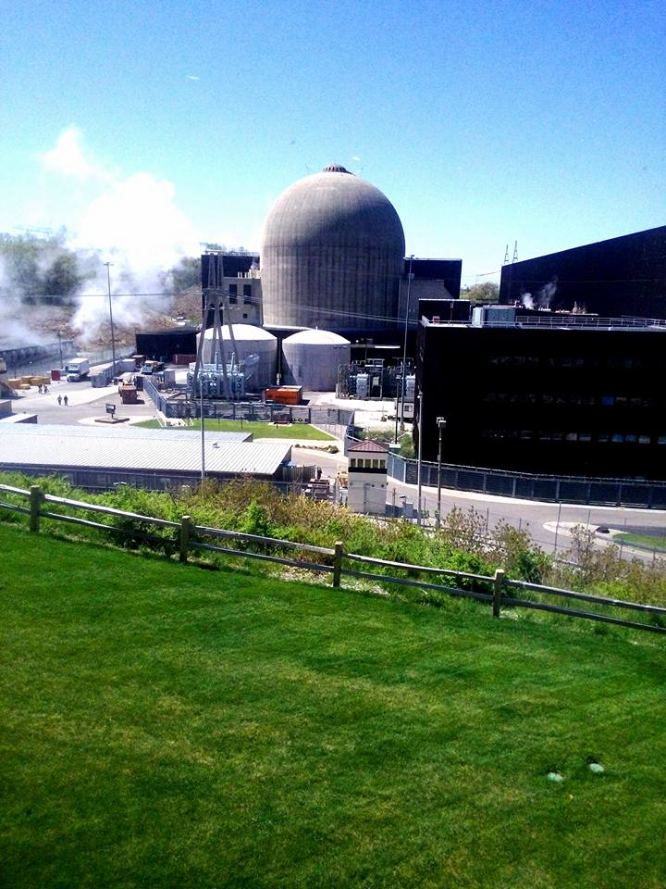
AUDIENCE STRATEGY IN SOCIALIZATION OF KALBAR NPP
IDENTIFICATION OF TARGET AUDIENCE
Knowledge Framework
(frame of reference)
Communication Situation
(Communication situations and the psychological physical state of the target audience)
Scope of Experience
( Field of experience)
The area of ​​residence is linked to the site plan.

Slide 17
KESIMPULAN
What must be done to encourage public communication related to NPP can take place effectively
"To build public understanding, positive perceptions and public acceptance of the NPP development plan, it is necessary to support public communication based on clear, objective, balanced, honest information delivered in a language that is easy to understand, which is communicated by a clear source and has authority, using all forms of mass media, social media and other media capable of providing dialogue space in various public arenas”
Mass Media :
Television
Newspaper
Radio
Megazine
Social Media :
Facebook
Instagram
Twitter
Face to Face Communications :
lectures,
Focus Group Disscusions, Deliberations, Gatherings
Cultural Attractions :
Poetry
Rhymes
Rhymes singing

Slide 18
Communication is the most effective medicine for treating various complicated and complicated conflicts
THANK YOU
Culture develops because communication and communication develop because of culture
Communication is an art, use the heart when displaying its beauty when talking

